Slide 1


Patient Activity Guide
Last update 12/29/16

Slide 2
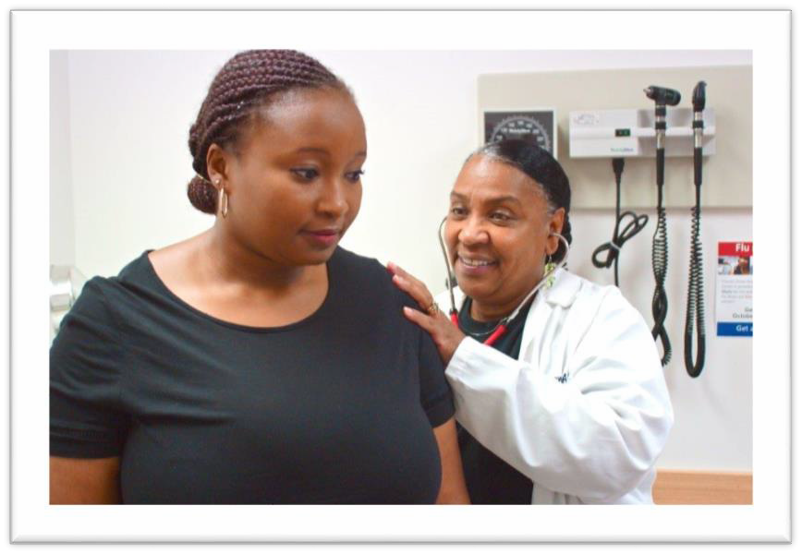
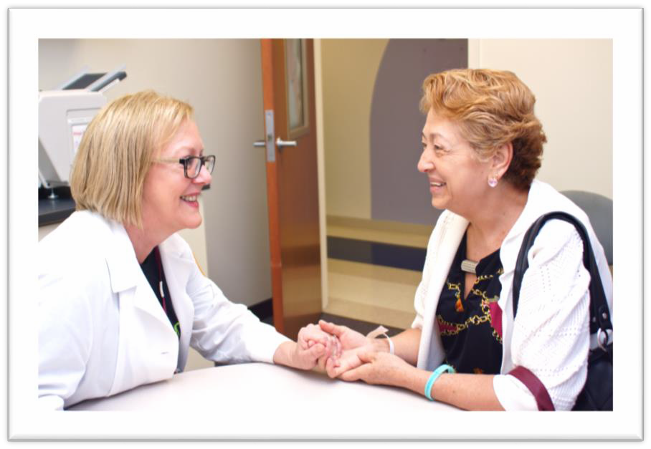


Welcome
We are happy to welcome you to the See, Test & Treat program!
Being here today is an important step toward staying healthy, for yourself and for your loved ones. We look forward to talking and learning with you.
This See, Test & Treat Patient Activity Guide information for learning about your health. It will also help you share what you learn with others.
At the end of today, you will be able to…
Describe healthy lifestyle choices that promote breast and cervical health, including screening and early detection through mammograms, Pap tests, and well woman visits.
Understand and discuss what cervical and breast cancers are.
Describe the roles of your Doctors and Nurses in helping you stay healthy.
Identify warning signs of cervical and breast cancer.
Let’s get started!
2

Slide 3





Learning About Your Health
During today’s education sessions, you will learn about your health through talking, listening,
and trying out some new things!
Please choose what you want to learn about most from the list below. Be sure to share it with your See, Test & Treat Team.
What topics interest you the most today? (check all that apply)
❑ Hearing stories about Patients in the See, Test & Treat program.
❑ Meeting your See, Test & Treat Healthcare Team.
❑ Seeing what healthy cells vs. unhealthy cells looks like.
❑ Recognizing signs and symptoms of cancer.
❑ Learning about services for screening and detection of cancer.
❑ Learning about treatment options.
❑ Choosing specific, healthy changes you can make in your day-to-day life to promote health.
❑ Being able to share what you learn today with your loved ones and your community.
3

Slide 4




Visit each education area, participate, and check off when done!
See, Test & Treat Education Activities Completed?
Visit ”Ask A Doc” Education Station.
Visit the Health Fair.
Visit a Health Insurance Navigator.
Visit “Make a Heathy Change” Education Station.
4

Slide 5
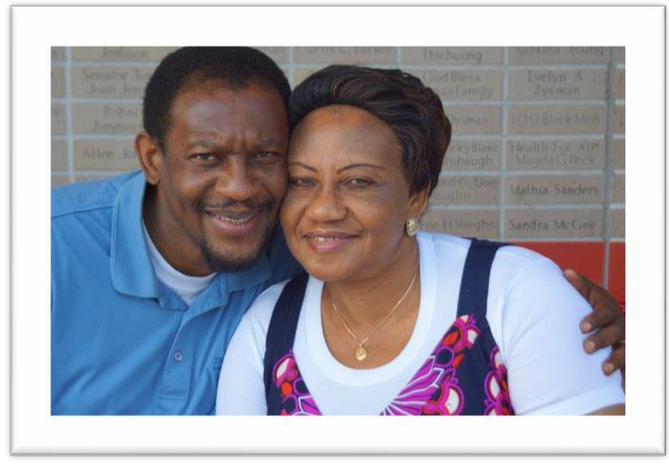

Common Health Questions
Here are some common questions we hear in the See, Test & Treat program:
Why do I need to get a mammogram?
Annual mammograms can detect cancer early — when it is most treatable. In fact, mammograms show changes in the breast up to two years before a Patient or Doctor can feel them!
From Uninsured and Undiagnosed to Treatment in 40 days
Why do I need to get a Pap test?
A Pap test screens for cervical cancer. If caught and treated early, cervical cancer is not life-threatening!
“We identified a breast lump in one of the See, Test & Treat Patients we screened. That day, we referred her to one of our care providers for follow-up care. She was able to get a biopsy right way, which confirmed that the lump was a malignant tumor. She had surgery within a week to remove the tumor.”
Why do I need to get screened for human papillomavirus (HPV)?
In women older than age 30, the Pap test may be combined with a test for HPV. HPV is a very common sexually transmitted infection that can cause cervical cancer.
Why should I lead a healthy lifestyle?
Exercise, healthy foods, and regular visits with your health care team will help give you more energy, get better sleep, and you will better be able to fight off illness. While not all illness can be prevented, most cancers can be greatly improved by being diagnosed early and receiving care right away.
Because of the See, Test & Treat program, she went from uninsured and undiagnosed to treatment in 40 days!
Leading a healthy lifestyle and getting health screenings saves lives!
₅ Submitted by Marilyn Kasmiersky, Director of Business Development | Lone Star Family Health Center | Conroe, Texas

Slide 6
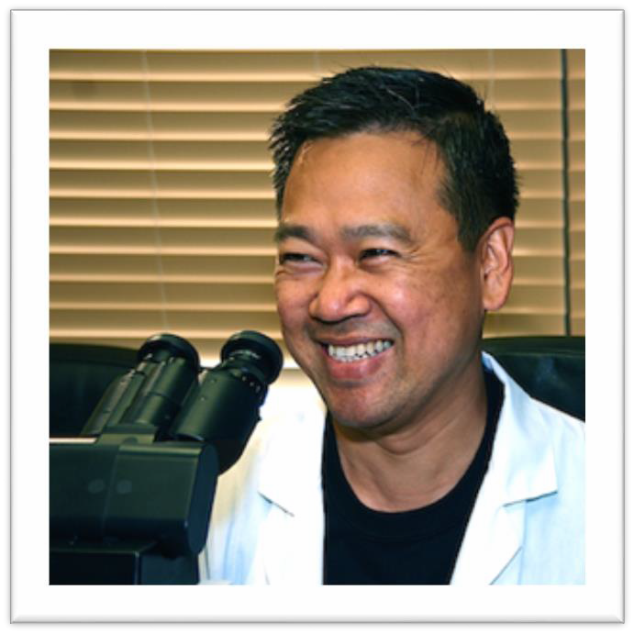
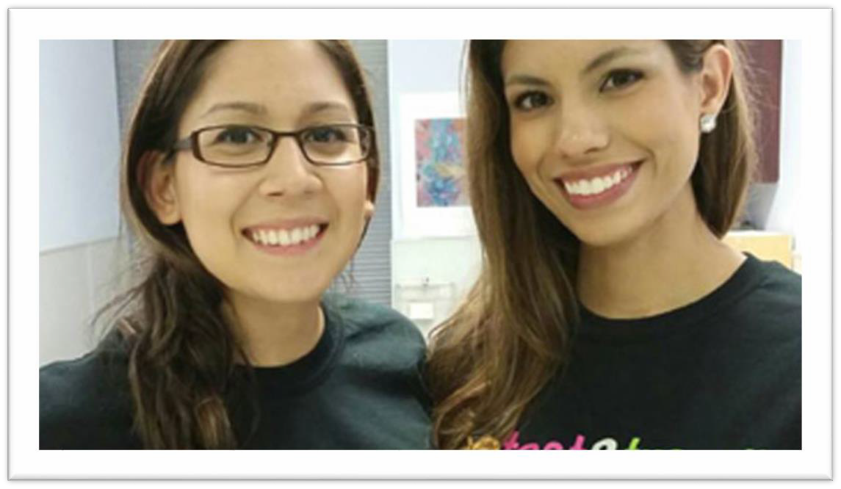
Your See, Test & Treat Program
No woman in America should die from undiagnosed breast or cervical cancer.
But thousands of women discover these cancers too late. This program is here to help!
There are no barriers here (such as language, transportation, and childcare) to you receiving care.
You receive your results on the same day you are screened.
You have the chance to review your results in person with a Doctor.
You have the chance to learn about your health directly from a Pathologist or Pathology Resident.
You can schedule any needed follow-up care on the same day.
What is the CAP Foundation’s role in See, Test & Treat?
With the support of the College of American Pathologists, the CAP Foundation has sponsored many See, Test & Treat programs, helping thousands of women
throughout the United States. The path to health starts with early diagnosis and this screening is the first step in disease prevention.
6

Slide 7


Your See, Test & Treat Team
You are being supported by a team of healthcare professionals.
The leaders of the See, Test & Treat program include Doctors who practice family medicine, pathology, radiology, and obstetrics/gynecology.
What is Family Medicine?
Family Medicine Doctors provide health care for people of all ages. At a family medicine clinic, you may meet with a
Primary Care Doctor, a Nurse Practitioner, or Physician Assistant.
What is a Pathologist?
Pathologists are Doctors who diagnose disease by looking at samples of blood and tissue. Pathologists communicate with your other Doctors to decide the best way for you to be healthy.
See, Test & Treat Team Spotlight Paula Kezdi-Rogus is a Radiologist at Loyola University. She shared:
What is a Radiologist?
Radiologists are Doctors who diagnose disease using mammograms and x-rays and other imaging techniques. Radiologists also communicate with your other Doctors to decide the best way for you be healthy.
“We try to reduce anxiety as much as we can,” Dr. Kezdi-Rogus. “It’s a scary thought that you may have an abnormality. But if we can tell a woman as fast as possible that
everything is benign, that makes it as easy and anxiety-free as possible.”
What is an Obstetrician and Gynecologist?
Obstetricians and Gynecologists (Ob/Gyn) are Doctors who provide care specifically for women. They are experts in pregnancy and childbirth.
Doctors in all of these roles, and more, work together to provide you with health care!
7

Slide 8
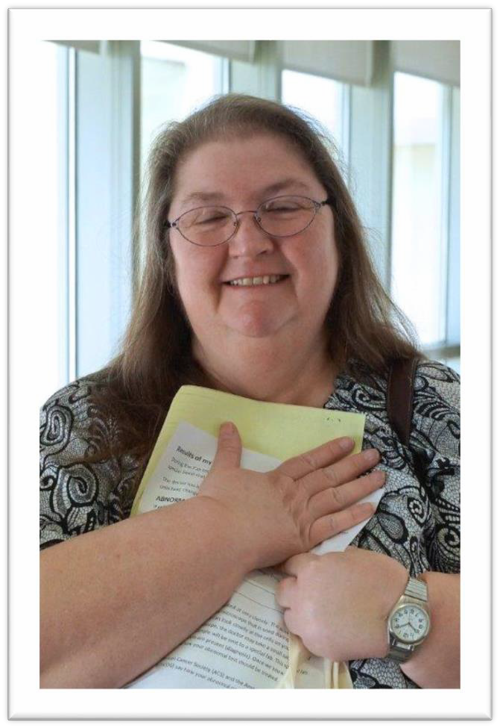
See, Test & Treat Patient Stories
Many women don’t have access to health care or must make difficult
choices to receive the care they need.
Some can’t afford adequate health care, but earn too much to qualify for Medicaid.
Some have to choose between daily expenses of home life and their own care.
Maria was one of them, until she participated in the See, Test & Treat program.
It had been seven years since Maria’s last mammogram, and she’d never been to the Doctor for a Pap test. At night, she couldn’t sleep. The pain in her breast was too severe and worry weighed on her.
One thing stood between Maria and regular screenings for cervical and breast cancer: Insurance.
“For those of us uninsured, we are our own Doctors,” Maria said. “We prescribe our own medication if we have fevers or need something like an antibiotic. We go out and get it where we can. Many of us preferred to pay for our children’s education than to pay for health insurance or medical services.”
Maria’s mammogram showed an abnormality in her breast. Every day, she’d thought about going to the Doctor. Choking back tears, she said she’s grateful she decided to take advantage of See, Test & Treat.
“They are going to follow me,” Maria said. “If I had not known about this program, I would have developed cancer and never been able to do anything about it.”

Slide 9

See, Test & Treat Patient Stories
Laura and Irma’s Story
They smile at each other and sometimes hold hands, finishing each other’s sentences. They’re mother and daughter. Irma lives with her daughter, Laura, and her grandson. Laura can’t imagine life without her.
“My mom is everything, so I need to take care of her,” Laura said. And she did on a cold,
rainy Saturday when she took her mother to See, Test & Treat.
“She doesn’t drive and she doesn’t have insurance,” she said. “We saw this was close to where we live, so we didn’t think twice. We just came.”
Over the years, they’ve neglected their health with infrequent visits to the Doctor. “As a child, I went to the Doctor only when I got sick,” Laura said. “When I was little, it was hard to go to the Doctors for checkups.”
Laura works as a machine operator and has insurance through her company. But her mother isn’t covered. Laura doesn’t work on Saturdays, so when she saw the ad for See, Test & Treat, she knew she had to bring her mother.
“It was important to check to see if she had some kind of cancer because you just never know,” she said.
Irma received favorable results. She and her daughter smiled at the end of the day, relieved that she is healthy.
9

Slide 10
Healthy Lifestyles

Slide 11

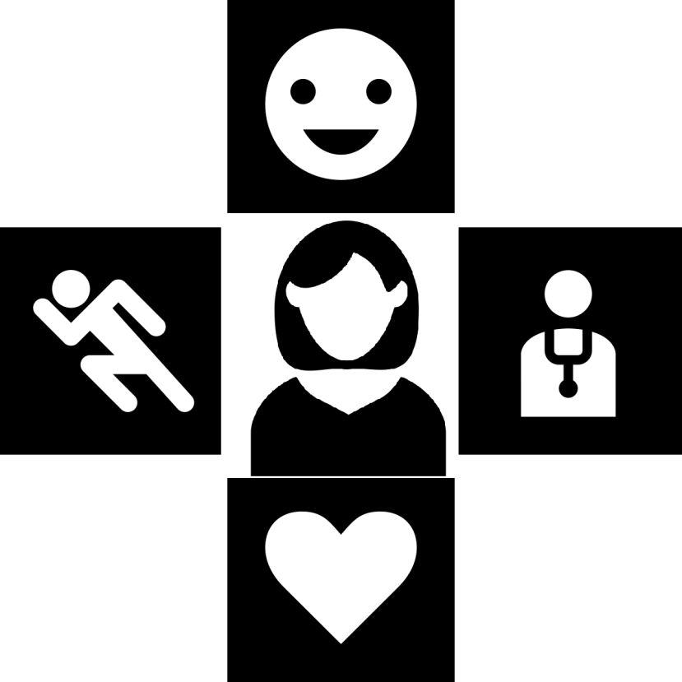






A Healthy Lifestyle Means…
Talking about family health history
Daily exercise
Avoiding alcohol
Regular health screenings and and well woman visits
Keeping a healthy weight
Choosing healthy foods
Not smoking
11

Slide 12
Facts About Healthy Lifestyles
Why is not smoking important?
Smoking weakens the immune system.
Lung cancer has surpassed breast cancer as the leading cause of cancer death in women! Approximately 90% of cases of lung cancer are caused by smoking or exposure to smoke.
Women who smoke are also at an increased risk of gynecologic cancer.
Tobacco use negatively affects every organ system in the body and is the most prevalent cause of premature death for adults within the United States.
Why is avoiding alcohol important?
Estrogen levels are often higher in women who drink alcohol than in non-drinkers. These higher estrogen levels may increase the risk of breast cancer.
Why is talking about family health history Important?
You can’t change your genes, but a healthier lifestyle could reduce risk for diseases that run in your family. Learn your family’s health history and talk to your Doctor about it.
Why are regular health screenings and well woman visits important?
Screening tests (such as mammograms and Pap tests) can detect diseases at an early stage when they are most treatable.
12

Slide 13
More Facts About Healthy Lifestyles
Why is daily exercise important?
Daily exercise is one of the best things you can do for your health. It helps:
  Control your weight
  Lower your risk of heart disease
  Lower your risk for type 2 diabetes
  Lower your risk of some cancers
  Make your bones and muscles stronger
  Improve feelings of well-being
  Increase your chances of living longer
Why is choosing healthy foods important?
There is an direct link between what you eat and how you feel.
Eating nutritious foods, like fruits and vegetables, can help reduce your cancer risk and help you maintain a healthy weight!
Why is a healthy weight important?
Obesity is a risk factor for health issues including heart disease, high blood pressure, type 2 diabetes, gallstones,
breathing problems, and certain cancers.
13

Slide 14

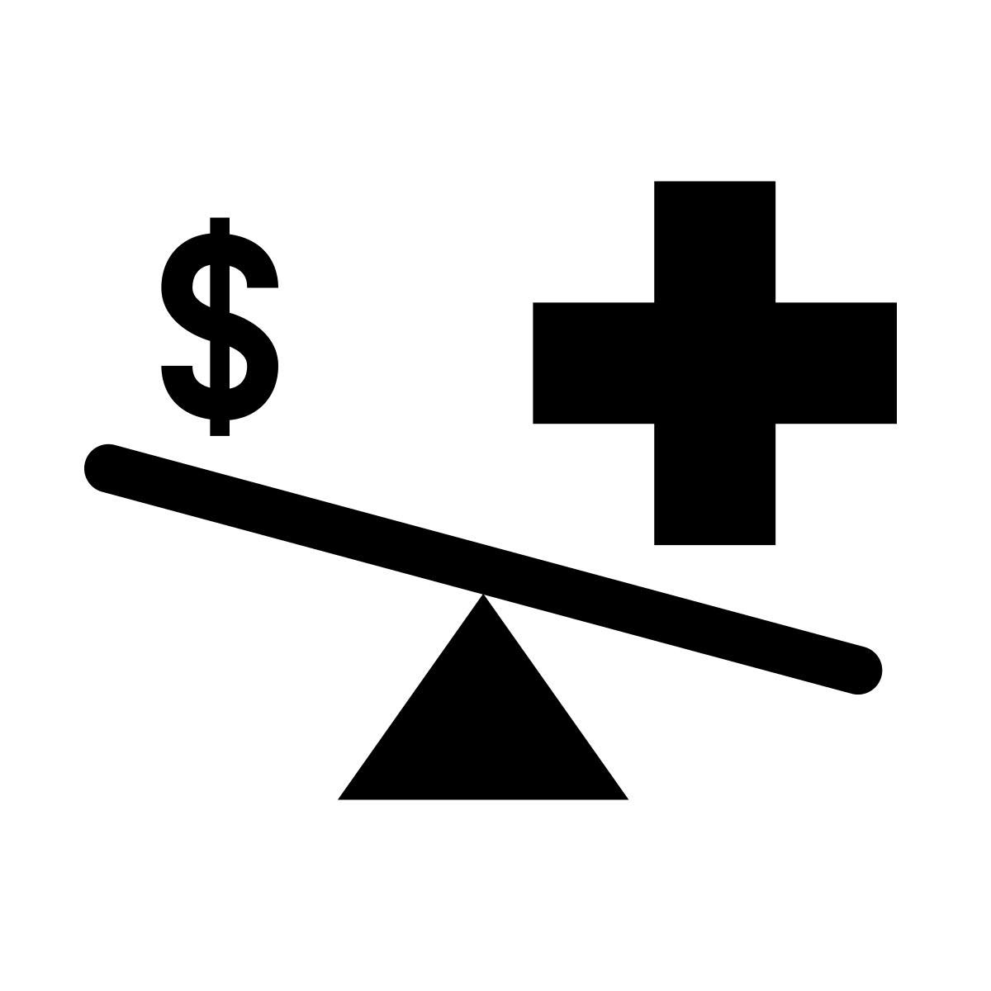
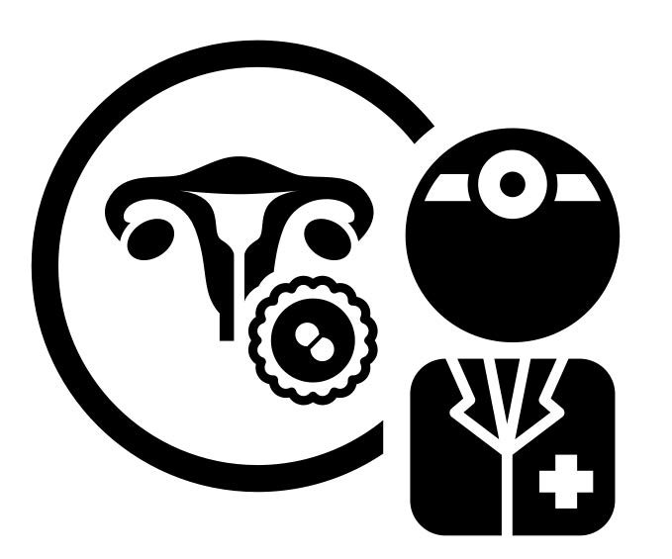

Common Barriers to a Healthy Lifestyle
Talk about it: Do any of these things stop you from leading a healthy lifestyle?
Language - don't understand words used during visits
Culture Barriers - feels like my culture isn't understtod by doctors
Childcare - kids get bored or are not welcome at health visits
Safety - no safe place to walk or safe access to exercise areas
Cost - can't afford health Insurance or recommended services
Embarrassment - afraid of getting examined or diagnosed with a disease
Healthcare System - confusion about available health services
Appointment Planning - too easy to forget, need reminders of health care
Access to Healthy Foods - healthy foods are expensive or take too long to prepare
Health Literacy - prevention of sickness doesn't seem possible, will wait until there is a problem
I am head of my household - too busy to balance it all!
Transportation - too difficult to get to health care appointments
other barriers?
what else keeps you from getting healthcare and keeping healthy habits?
14

Slide 15


What You Should Know About Cancer
Did You Know?
Cancer is an abnormal growth of cells within the body.
Cancer is the second leading cause of death for American women.
Women’s bodies are constantly changing. Paying attention to those changes for anything that looks
or feels abnormal for you is important for maintaining good health!
There are 5 cancer indicators you should watch for:
Breast changes
Prolonged bloating that does not get better with time
Unusual bleeding
Blood in your urine or stool
Excessive weight loss without trying
Cancer Screening Glossary
Screening Test: A test that looks for possible signs of disease.
Biopsy: A minor surgical procedure to remove a small piece of tissue that is then examined in a laboratory.
Benign: Not cancer.
Early detection can make all the difference for effective treatment!
If you’re unsure of something or you simply don’t feel well, do not wait to contact a Doctor.
Source of five indicators: http://www.ahchealthenews.com/2016/10/04/cancer-pay-attention-5-signs/
Malignant: Cells or tumors that are able to invade tissue and spread to other parts of the body.
15

Slide 16
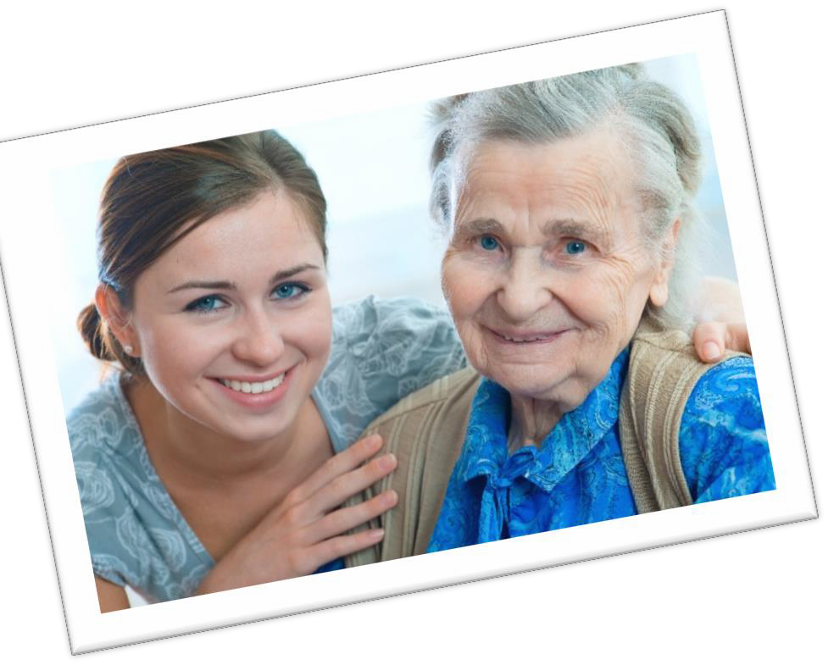




Give Healthy Lifestyle Advice
to Elena and Jessica!
If you could give advice to Elena and her granddaughter, Jessica, you would tell them both to stay healthy by:
(circle all healthy behaviors below)
Daily exercise
Avoiding alcohol
Keeping a healthy weight
Talking about family health history
Regular health screenings and well woman visits
Choosing healthy foods
Not smoking

Slide 17
Cervical Health

Slide 18
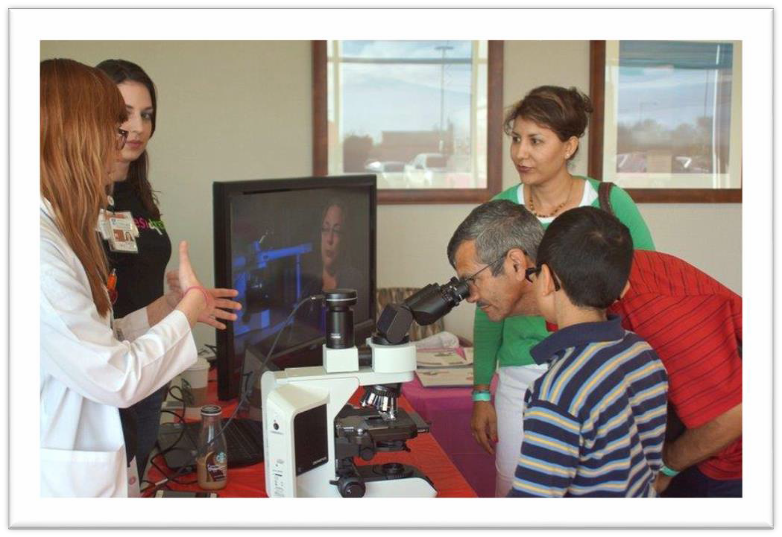
Facts About Cervical Cancer
What is Cervical Cancer?
Cervical cancer starts when cells within the cervix grow out of control.
DidYou Know?
Embarrassment is one of the major causes of not getting tested for cervical cancer.
Even though women may feel something is wrong, they may not seek help due to fear.
Men have a very important role to play in cervical health. Their support is critical. Many women need encouragement to get their routine screenings
Most cases of cervical cancer are caused by infection with HPV, a sexually transmitted virus that enters cervical cells and can cause them to change.
There are 12,000 new cervical cancers diagnosed in the U.S. per year.
There are over 3,500 preventable deaths from cervical cancer each year.
In the United States, Hispanic women are most likely to get cervical cancer, followed by African-Americans, Asians and Pacific Islanders, and Caucasians. American Indians and Alaskan natives have the lowest risk of cervical cancer in this country.
In most cases, problems can be prevented through early detection and treatment before cancer develops!
18

Slide 19
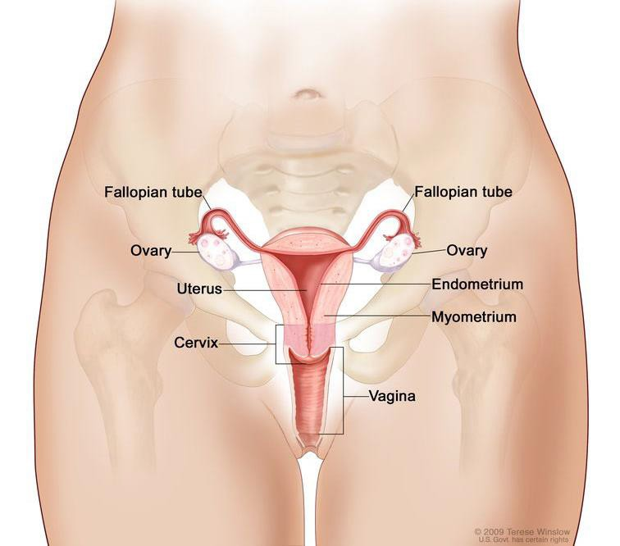
Key Terms Related to Your Cervical Health
If you aren’t sure what a word means, please ask!
Key Terms
Cervix: The cervix is the part of the female reproductive system that connects the uterus (womb) to the vagina. It is made up of strong muscles and it functions like a tunnel, allowing the flow of menstrual blood (your monthly period) from the uterus into the vagina and directs sperm into the uterus during intercourse.
Endometrium: The endometrium is the tissue lining the inner cavity of the uterus (or womb). In women of childbearing age, this inner layer of the uterus goes through a series of monthly changes known as the menstrual cycle.
Fallopian Tubes: The pair of tubes along which eggs travel from the ovaries to
the uterus.
Myometrium: The smooth muscle tissue of the uterus.
Ovaries: Where ova or eggs are produced.
Uterus: A hollow, pear-shaped organ that is located in a woman's lower abdomen, between the bladder and the rectum. It is the organ where a fetus grows until birth.
Vagina: the muscular and tubular part of the female genital tract, which in humans extends from the vulva to the cervix.
Vulva: The external female genital area.
Vulva
Image source: https://www.cancer.gov/types/cervical/understanding-cervical-changes
19
Illustration available via CC BY-ND 3.0 DE

Slide 20
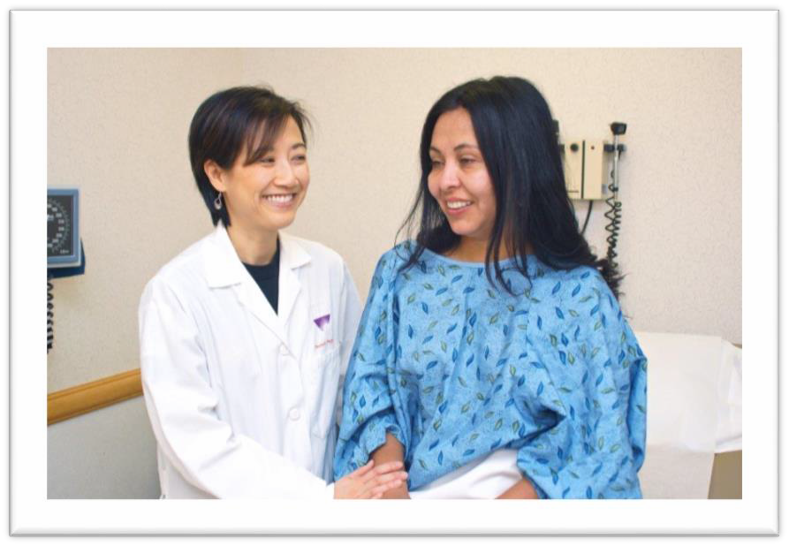

Pelvic Exams and Pap Tests Save Lives!
The pelvic exam has three parts:
Looking at the vulva.
Looking at the vagina and cervix with a speculum.
Checking the internal organs.
A Pap test checks for abnormal changes in the cervix that could lead to cancer. During a Pap test, a sample of cells is taken from your cervix with a small brush and examined under a microscope.
An abnormal test result does not mean you have cancer. Women with abnormal Pap test results are usually examined further.
Cervical Care Glossary
Colposcopy: This gives your Doctor a better look at your cervix using an instrument called a colposcope to shine a light on your cervix and magnify it. If an abnormal area is seen, a biopsy will be done.
Your health care team is here to make you comfortable!
Hysterectomy: Removal of the uterus.
Please tell your Doctor if something frightens or bothers you or if you are not sure what something means.
Loop electrosurgical excision procedure (LEEP)—A thin wire loop that carries an electric current remove abnormal areas of the cervix.
Conization: A cone-shaped p₂₀iece of the cervix that contains the abnormal cells is removed.
Image courtesy of ACOG

Slide 21


Signs of Cervical Cancer
Note: Women with early cervical cancers and pre-cancers usually have no symptoms!
That is why regularly scheduled exams are essential, so be sure to get a well woman exam once a year.
Remember...cervical cancer starts when cells within the cervix grow out of control.
Symptoms often do not begin until the cancer grows into nearby tissue.
When this happens, common symptoms are:
❑ Abnormal bleeding
❑ Pelvic pain not related to your menstrual cycle
❑ Heavy or unusual discharge that may be watery, thick, and possibly have a bad odor
❑ Increased urinary frequency
❑ Pain during urination or difficulty urinating
Pain or difficulty during urination or pain during intercourse.
If you ever do have any of these symptoms, please see a health care professional right away.
21
Abnormal bleeding or unusual discharge from the vagina

Slide 22
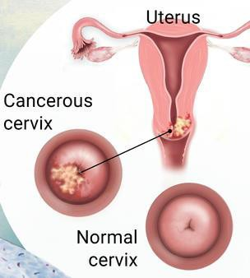
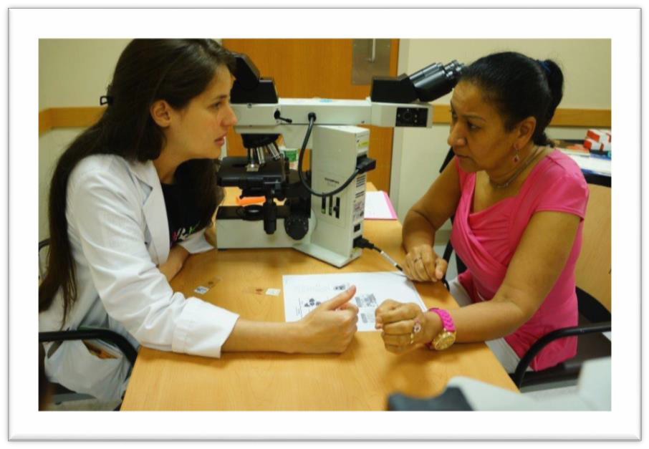
Types of Cervical Cancer
The most common type of cervical cancer is squamous cell carcinoma.
Squamous cells are thin, flat cells that look like fish scales, and are found in the tissue that forms the surface of the skin.
The squamous cells right at the entry of the cervix, at the outermost layer of the skin, are most susceptible to human papilloma virus (HPV).
This is why we do the Pap test and will discuss your test results with you.
Image source: https://www.cancer.go²v²/types/cervical/understanding-cervical-changes

Slide 23
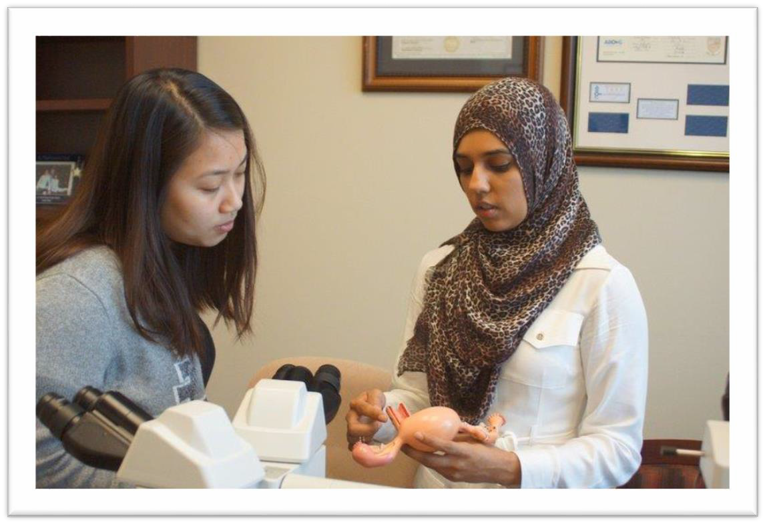

Facts About Cervical Cancer
By age 50, at least 80% of women will have acquired human papillomavirus, also know as HPV.
Men can pass to women and women can pass it to men.
Most people with HPV show no symptoms.
In most cases HPV goes away, but women with persistent HPV are at risk for developing cancer.
What Can You Do for Your Cervical Health?
A Pap test is recommended starting at age 21.
Women aged 21–29 years should have a Pap test alone every 3 years.
Women aged 30–65 years should have a Pap test and an HPV test (co-testing)
every 5 years. It is acceptable to have a Pap test alone every 3 years.
Women who have a history of cervical cancer, are infected with human immunodeficiency virus (HIV), have a weakened immune system, or who were exposed to diethylstilbestrol (DES) before birth may require more frequent screening.
An Important Note about HPV
HPV is not the same as human immunodeficiency virus (HIV, which causes AIDS) or herpes simplex virus (HSV, which causes cold sores and genital herpes).
Talk to your Doctor today about the Pap test and HPV screening!
23

Slide 24
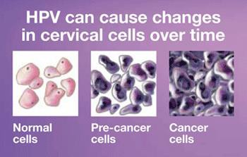
More About HPV and Cervical Health
Almost all cervical cancer is caused by a persistent infection with the human papillomavirus (HPV).
HPV can infect cells on the surface of the skin, the genitals, anus, mouth and throat.
The most common way HPV is spread is sexual contact, including vaginal, anal, and oral sex.
Certain types of HPV may cause warts on or around the female and male genital organs and in the anal area. These warts are seldom linked to cancer.
Other types of HPV are high-risk because they are strongly linked to cancer of the cervix, vulva, and vagina in women, penile cancer in men, and cancers of the anus, mouth, and throat in both men and women.
Know Your HPV Status!
Due to HPV being sexually transmitted, some women will not get tested because they fear being judged. But if caught and treated early, cervical cancer is not life- threatening!
Cervical cells go through a series of pre-cancer changes before they turn into cervical cancer.
A Pap test will show if your cells are going through these changes.
Image source: cdc.gov
The diagram above shows : Normal cells changing to Pre-cancer cells changing to Cancer cells
24

Slide 25
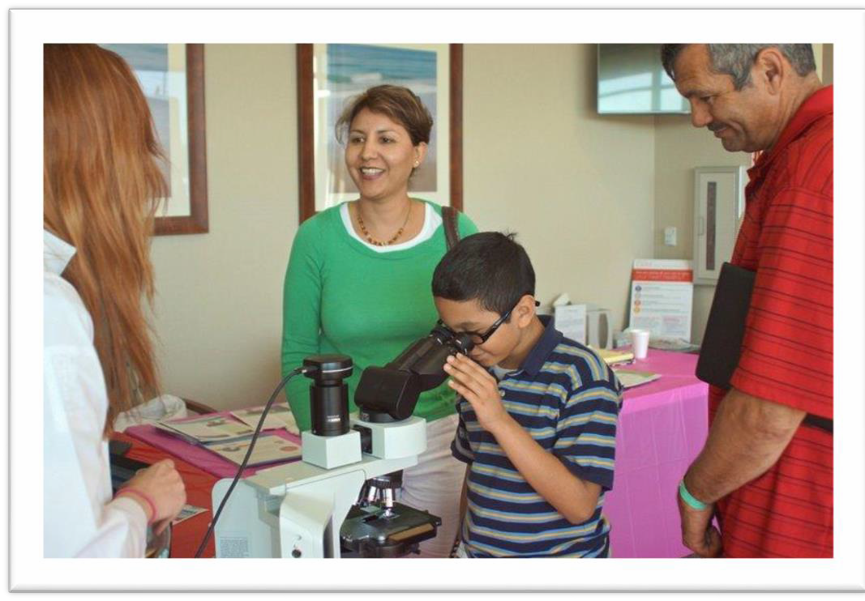

HPV Vaccinations for Pre-Teens and Young Adults
Why vaccinate pre-teens and young adults for human papillomavirus (HPV)?
HPV infection can eventually cause cervical, vaginal, vulvar, penile, anal, and
throat cancer, and genital warts.
HPV vaccination can significantly reduce the incidence of anus and genital cancer and genital warts as our children grow up and are potentially exposed.
When should you vaccinate?
Ask your pediatrician or family Doctor about getting the HPV vaccine for your pre-teen and young adult family members.
The Centers for Disease Control and Prevention recommends the HPV
vaccine for both girls and boys between the ages of 11–12 years old.
If your teen did not start or finish the HPV vaccine series when they were younger, talk to your pediatrician or family Doctor about getting it for them as soon as possible.
  Girls and women may receive the HPV vaccine through age 26, and boys
and men through age 21.
Need help paying for the HPV vaccine?
Ask your Doctor about “The Vaccines for Children (VFC)” program provides vaccines for children ages 18 years and younger, who are uninsured, Medicaid- eligible, American Indian or Alaska Native.
25

Slide 26

Do These Things for Cervical Health
These steps can help lower your risk of cervical cancer:
❑ If you are over 30, get tested for HPV: The most important risk factor for cervical cancer is infection by HPV. Know your status!
❑ Quit Smoking: Women who smoke are about twice as likely as non-smokers to get cervical cancer.
❑ Keep a Healthy Weight: Overweight women are more likely to develop a form of cancer of the cervix.
❑ Talk About Your Family History: You may be at high risk of cervical cancer if you have a mother or sister who developed cervical or ovarian cancer (especially at an early age) or if you have multiple family members (including males) who developed cervical, ovarian or prostate cancer.
❑ Most importantly, Keep Getting Screened! Regularly scheduled cervical cancer screening remains the single best way to protect yourself from the disease! If you have any questions about the tests, be sure to talk to your Doctor.
26

Slide 27
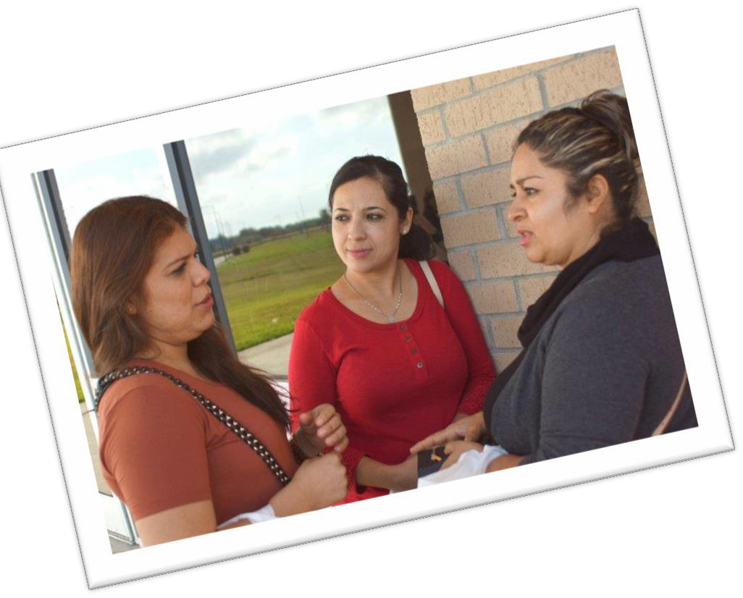

Help These Friends Talk
About Cervical Health and HPV!
This is Valeria and her closest friends. Valeria is feeling embarrassed about getting a diagnosis of HPV.
Valeria’s friends want her to stay healthy
and feel supported!
Her friends should tell her…
(circle everything that is true below)
Many women get HPV and it will probably just go away, but she has to get regularly screened to make sure!
Keep getting pelvic and Pap exams and talk to a Doctor immediately if she ever has discharge, bleeding, or feels pain.

Slide 28
Breast Health

Slide 29
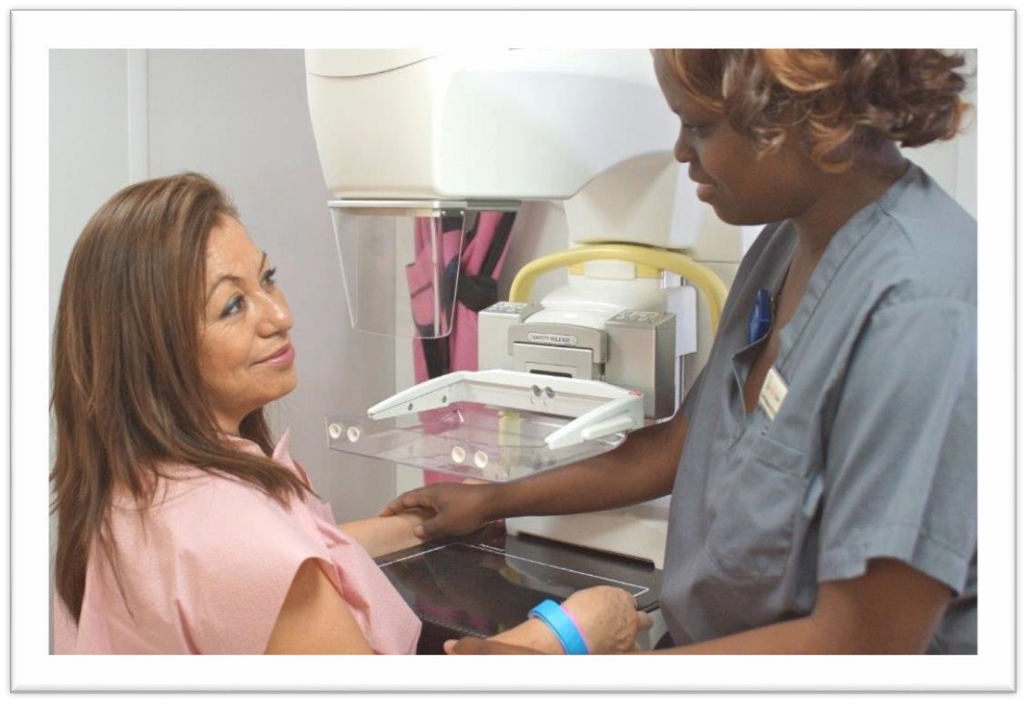

Facts About Breast Cancer
What is Breast Cancer?
Breast cancer starts when cells within the breast grow out of control.
DidYou Know?
Men can get breast cancer.
White women are more likely to get breast cancer.
African American and Hispanic women are more likely to die of breast cancer.
In most cases, problems can be prevented through early detection and treatment!
Women aged 29–39 years should have a clinical breast exam every 1–3 years.
Women aged 40 years and older should have a mammogram every year.
The most common breast cancer risk assessment test is the National Cancer Institute’s Breast Cancer Risk Assessment Tool, which estimates the likelihood of developing breast cancer over a lifetime. It can be accessed online at http://www.cancer.gov/bcrisktool
A mammography is a procedure in which X-rays are used to detect breast cancer.
Talk to your Doctor today about your personal risk of breast cancer!
29

Slide 30

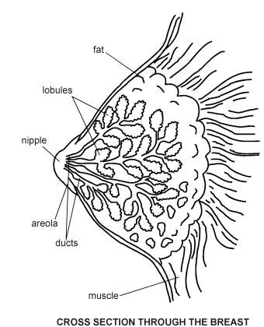
Key Terms Related to Your Breast Health
Your medical team may use words you are not familiar with.
If you aren’t sure what a word means, be sure to ask!
Patient education is part of the services Doctors and Nurses provide.
It is critical for you to ask them about everything related to your health. Remember, you are an essential partner in your health care!
Key Terms Related to Your Breast Health
You will often hear the term mammary used in reference to
breasts.
The female breast is mostly made up of a collection of fat cells called adipose tissue.
An average female breast is made up of 12–20 sections called lobes, which are made up of many smaller lobules, the glands that produces milk in nursing women.
Both the lobes and lobules are connected by milk ducts, which act as stems or tubes to carry the milk to the nipple.
Areola surround the nipple.
Image source: http://Patient.info/diagram/breast-diagram
30

Slide 31
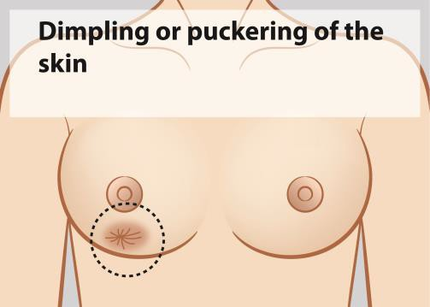
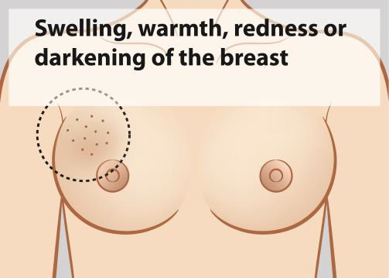
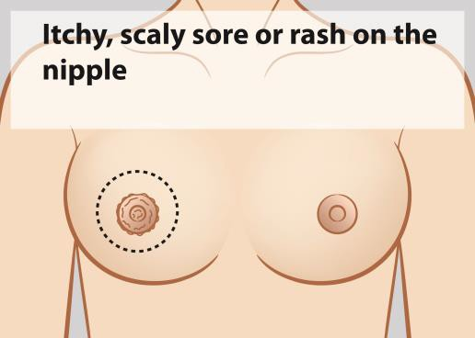
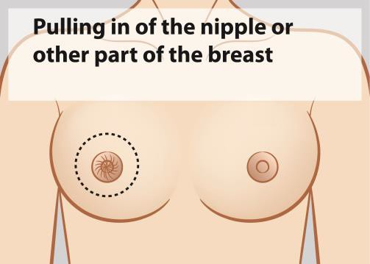
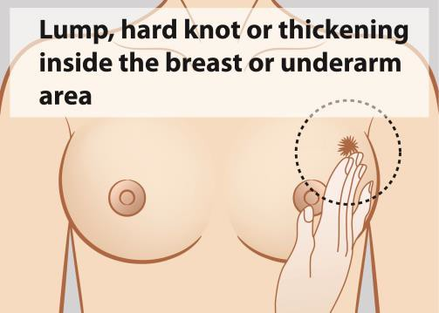
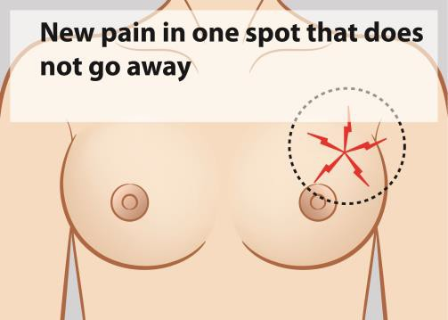
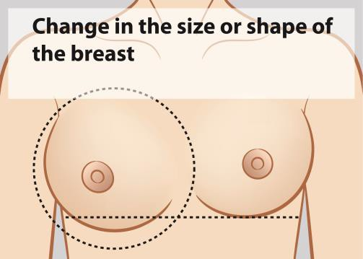
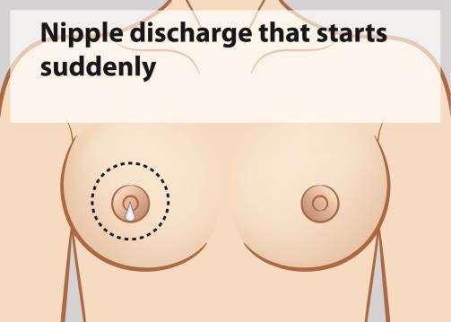
Signs of Breast Cancer
The signs of breast cancer are not the same for all women,
so it is very important to know how your breasts normally look and feel.
Skin irritation or dimpling of breast skin
Redness, darkening, or warmth of the breast
If you notice any change, see your Doctor!
Redness, itchiness, soreness or or thickening of the nipple
Nipple or breast retraction (turning inward)
Can you recognize the signs and symptoms of breast cancer?
❑ Skin irritation or dimpling of breast skin
❑ Redness, darkening, or warmth of the breast
❑ Redness, itchiness, soreness or thickening of the nipple
❑ Nipple or breast retraction (turning inward)
❑ A lump in the breast or under the armpit
❑ Breast or nipple pain
❑ Swelling of all or part of a breast (even if no lump is felt)
❑ Nipple discharge (other than breast milk)
A lump in the breast or under the armpit
Breast or nipple pain
Swelling of all or part of a breast (even if no lump is felt)
Nipple discharge (other than breast milk)
31

Slide 32
Do These Things for Breast Health
These simple steps can help lower your risk of breast cancer:
❑ Maintain a Healthy Weight: Being overweight can increase the risk of many different cancers, including breast cancer.
❑ Be Physically Active: Women who are physically active for at least 30 minutes a day have a lower risk
of breast cancer.
❑ Avoid Too Much Alcohol: Only drink alcohol if you drink moderately, which means no more than one drink a day for women.
❑ Breastfeed, If Possible: Breastfeeding lowers the risk of breast cancer. It also has great health benefits
for your child!
❑ Avoid Post-Menopausal Hormones: If women do take post-menopausal hormones, it should be for the shortest time possible. Talk about the risks and benefits of post-menopausal hormones with your Doctor.
❑ Talk About Your Family History: You may be at high risk of breast cancer if you have a mother or sister who developed breast or ovarian cancer (especially at an early age) or if you have multiple family members (including males) who developed breast, ovarian or prostate cancer.
❑ Most importantly, Keep Getting Screened! Regularly scheduled breast cancer screening remains the
single best way to protect yourself from the disease. Screening can help find cancer early, when it’s
most treatable!
32

Slide 33
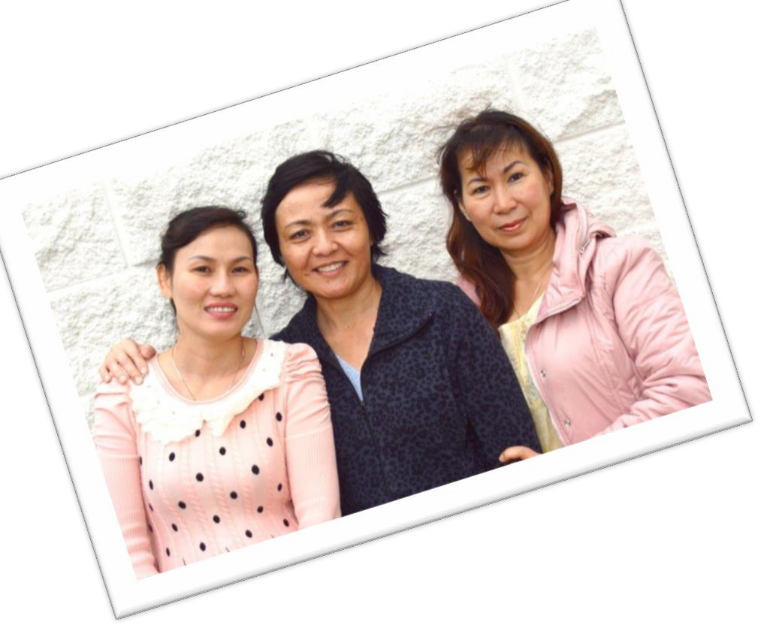

Help Lia Talk to Her Friends about Breast Health!
This is Lia and her closest friends.
They are all over 40 years old.
Lia wants to give her friends advice to stay healthy!
The best thing she can tell her friends about breast health is:
(circle your advice below)
Get an annual
mammogram, do a monthly self-check, and talk to a Doctor if they ever notice changes in their breasts.
Since they’ve never had a problem, tell them don’t worry about it!

Slide 34




Healthy Lifestyle Notes
Cervical Health Notes
Breast Health Notes
Breast Health Notes
Your Important Notes
Other Important Notes
34

Slide 35
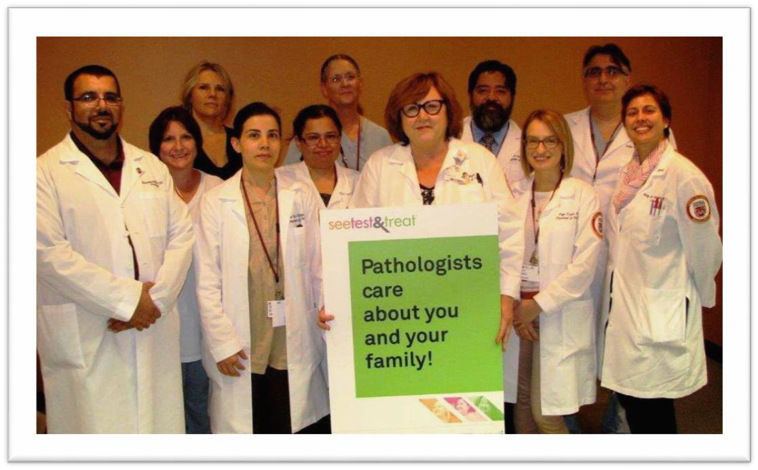


Learning Summary
You should now be able to…
Describe healthy lifestyle choices that promote breast and cervical health, including screening and early detection through mammograms, Pap tests, and well woman visits.
Understand and discuss what cervical and breast cancers are.
Describe the roles of your Doctors and Nurses in helping you stay healthy.
Identify warning signs of breast and cervical cancer.
You have taken an important step toward
For more information about See, Test & Treat, please contact:
College of American Pathologist Foundation
325 Waukegan Road
Northfield, IL 60093-2750
Phone (847) 832-7438
staying healthy by being with us today.
Please tell a family member or friend about your experience with the See, Test & Treat program so they can consider screening, too!
35

Slide 36



References for Information in this Guide
American College of Radiology
American Cancer Society
American Diabetes Association
American Society of Clinical Oncology
Cancer Centers of America
Centers for Disease Control
World Health Organization
American Heart Association
National Institute of Health
National Cervical Cancer Coalition
American College of Obstetricians and Gynecologists
Association of Reproductive Health Professionals
“I’m very happy this program is available.
All of the health and lifestyle education provided is greatly
appreciated. I think it is a great way to keep our community healthy.”
Foundation for Women’s Cancer
College of American Pathologists
Do you have questions
about what you learned today?
Acknowledgements
Artwork images within this guide were provided by The Noun Project artists: Marie Van den Broeck, Romzicom, Marco Fleseri, Alex Sheyn, Carla Dias, Gabor Fulop, Claire Jones, Lemon Liu, Martin Vanco, lastspark, Wilson Joseph, Karolina Brantas, Delwar Hassain, Clockwise, Melissa Schmitt, and Yazmin Alanis. Accessed December 2016
Image sources: Winslow, Teresa. https://www.cancer.gov/types/cervical/understanding-cervical-changes. Updated 2009. Accessed December 2016; https://www.cdc.gov/cancer/hpv/pdf/HPV_Testing_2012_English.pdf. Accessed December 2016; http:// Patient.info/diagram/breast-diagram. Accessed December 2016
Photography: Jill Barrett Photography
Do you need help
finding additional health services?
We would love to talk³⁶to you. Just ask!

Slide 37
Thank you for being with us today!
This Patient Activity Guide is the property of the CAP Foundation.
The material within is presented for entirely non-profit, educational purposes. Permission to reproduce this work, in part or in entirety, for any purpose other than use in the See, Test & Treat program must be granted in writing by the CAP Foundation.

