Slide 1
Patient Education Presentation
This educational module is the property of the CAP Foundation. The material within is presented for entirely non-profit, educational purposes. Permission to reproduce this work, in part or in entirety, for any purpose other than use in the See, Test & Treat program must be granted in writing by the CAP Foundation.
Last update 12/29/16

Slide 2
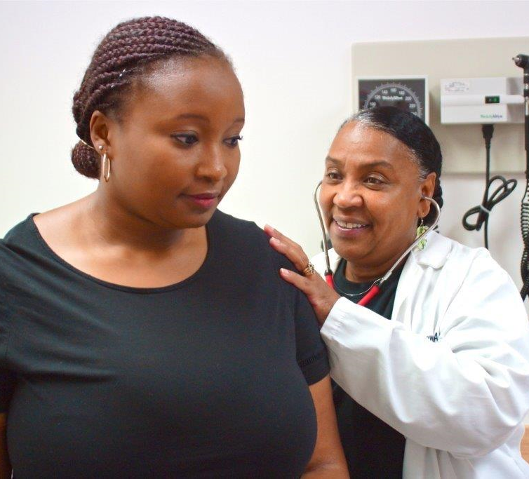
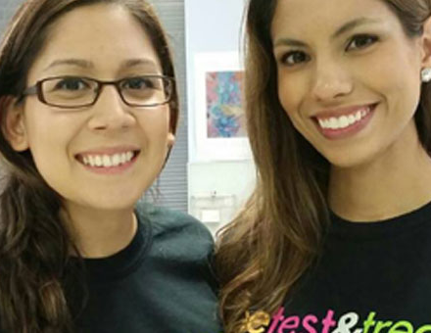
Welcome
Being here today is an important step toward staying healthy, for yourself and for your loved ones. We look forward to talking and learning with you.
Let’s get started!
Notes:
At the end of today, you will be able to…
Discuss what breast cancer is.
Describe the roles of your Doctors and nurses in helping you stay healthy.
Identify warning signs of breast cancer.
Describe behaviors and lifestyle choices that promote breast health, including screening and early detection through mammograms and well woman visits.
Tell them that the printed See, Test & Treat Patient Activity Guide provides stories and information for learning about breast health. It will also help them share what they learn with others.

Slide 3
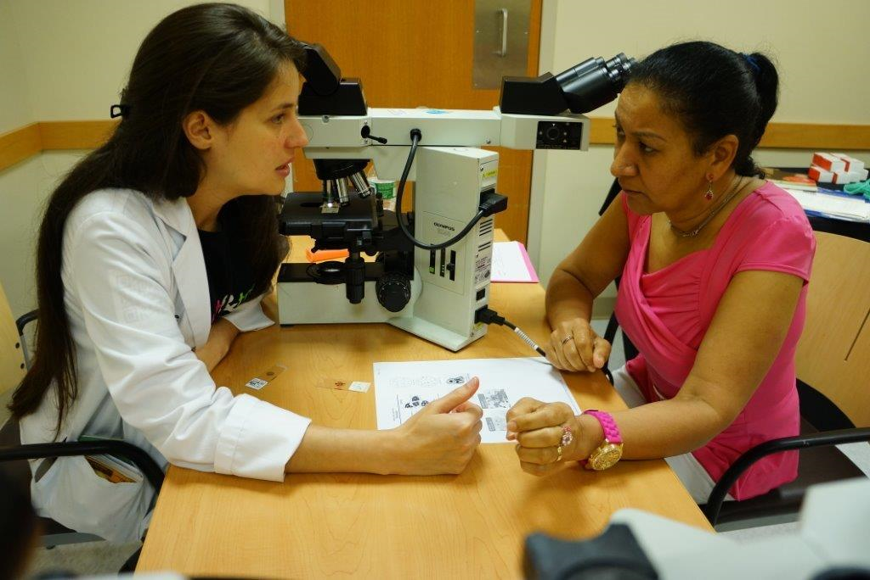
Learning About Your Health
During today’s education session, you will learn about your health through talking, listening, and trying out some new things!
What topics interest you the most today?

Slide 4
Healthy Lifestyles

Slide 5
A Healthy Lifestyle Means…
Talking about
family health history
Daily exercise
Avoiding alcohol
Regular health screenings and and well woman visits
Keeping a healthy weight
Choosing healthy foods
Not smoking

Slide 6
Common Barriers to a Healthy Lifestyle
Talk about it: Do any of these things stop you from leading a healthy lifestyle?
Language – Don’t understand words used during visits
Culture Barriers – Feels like my culture isn’t understood by doctors
Childcare – Kids get bored or are not welcome at health visits
Cost – Can’t afford health insurance or recommended services
Healthcare System – confusion about available health services
Access to Health Foods – healthy foods are expensive or take too long to prepare
Safety – no safe place to walk or safe access to exercise areas
Embarrassment – afraid of getting examined or diagnosed with
a disease
Appointment Planning – too easy to forget, need reminders of health care
Health Literacy – prevention of sickness doesn’t seem possible, will wait until there is a problem
I am head of my household – too busy to balance it all!
Transportation – too difficult to get to health care appointments
Other barriers?
What else keeps you from getting healthcare and keeping healthy habits?

Slide 7
What You Should Know About Cancer
Cancer is an abnormal growth of cells within the body.
Cancer is the second leading cause of death for American women.
Women’s bodies are constantly changing, and paying attention to changes is one key to good health.
There are 5 cancer indicators you should watch for:
Breast Changes
Prolonged Bloating that does not get better with time
Unusual Bleeding
Blood in your Urine or Stool
Excessive Weight Loss without Trying
Early detection can make all the difference!
If you’re unsure of something or you simply don’t feel well, do not wait to contact a Doctor.
Source of five indicators: http://www.ahchealthenews.com/2016/10/04/cancer-pay-attention-5-signs/
Cancer Screening Glossary
Screening Test: A test that looks for possible signs of disease.
Biopsy: A minor surgical procedure to remove a small piece of tissue that is then examined in a laboratory.
Benign: Not cancer.
Malignant: Cells or tumors that are able to invade tissue and spread to other parts of the body.

Slide 8
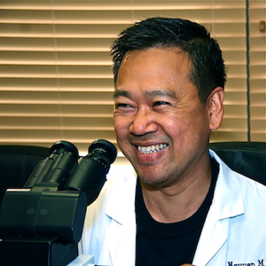
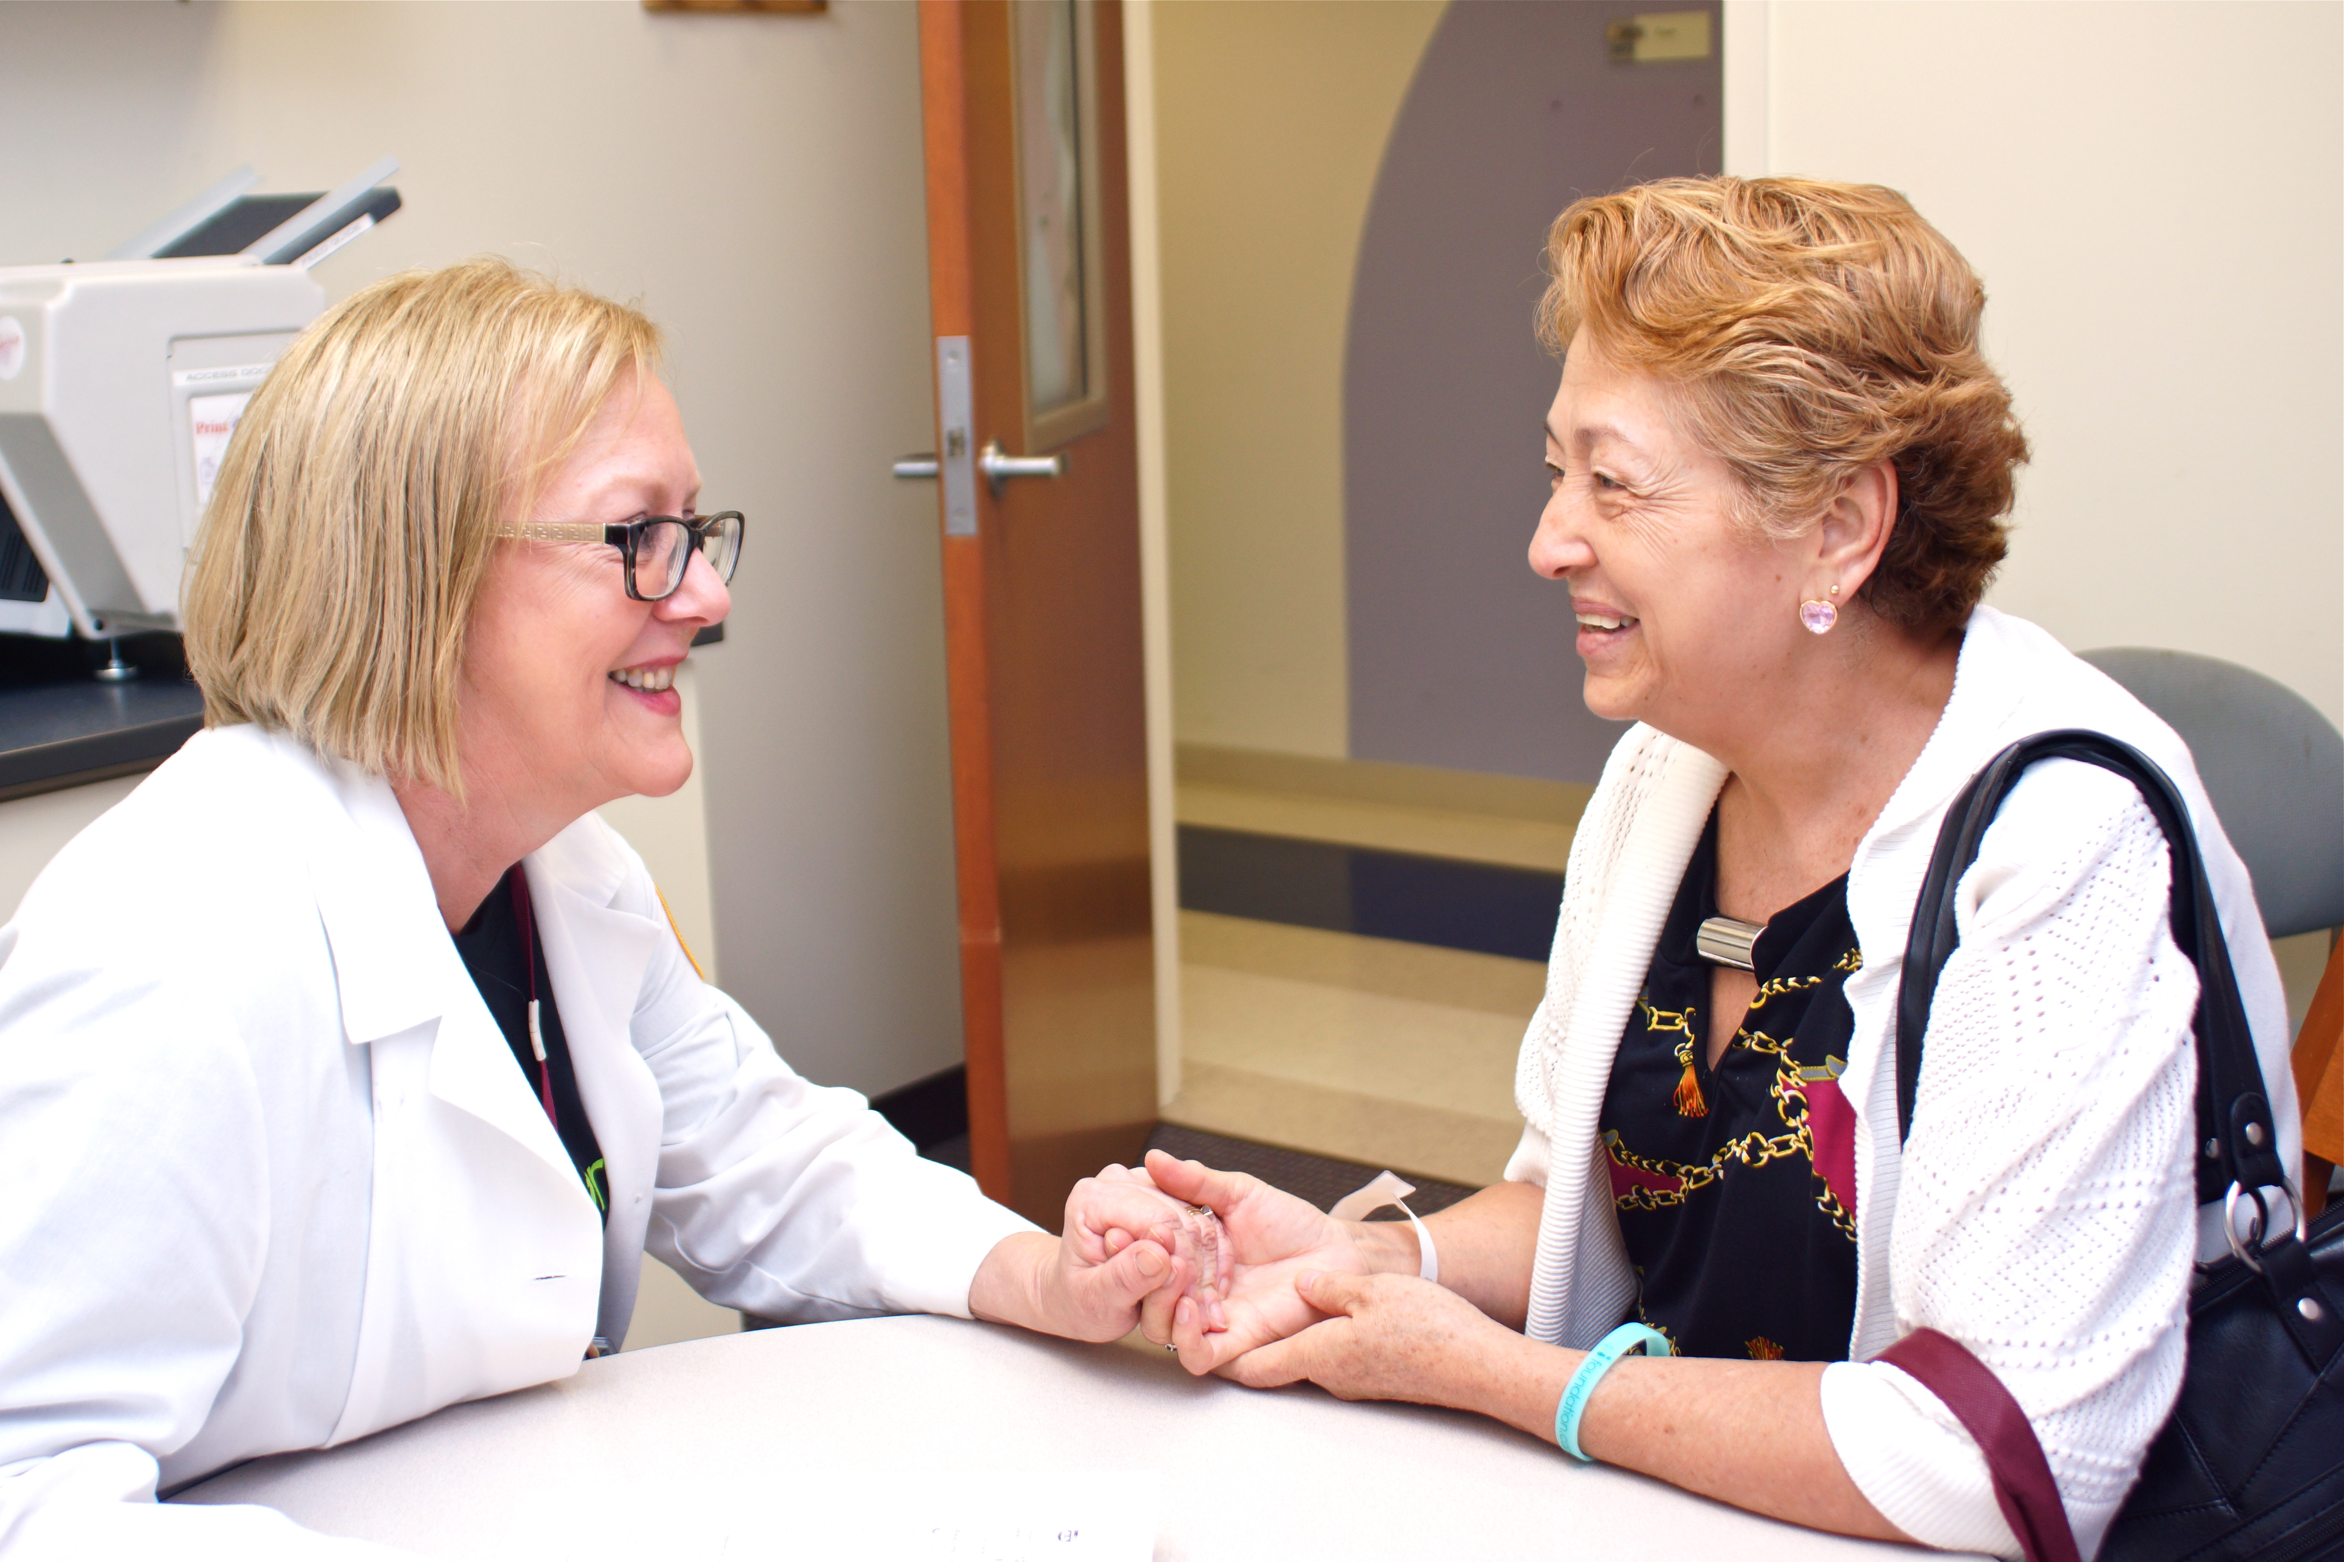
The Roles of Your See, Test & Treat Team
You are being supported by a team of healthcare professionals!
What is Family Medicine?
What is a Pathologist?
What is a Radiologist?
What is an Obstetrician and Gynecologist?
Doctors and nurses in all of these roles, and more, work together.
Notes:
What is Family Medicine?
Family Medicine Doctors provide health care for people of all ages. At a family medicine clinic, you may meet with a primary care Doctor, a nurse practitioner, or physician assistant.
What is a Pathologist?
Pathologists are Doctors who diagnose disease by looking at samples of blood and tissue. Pathologists communicate with your other Doctors to decide the best way for you to be healthy.
What is a Radiologist?
Radiologists are Doctors who diagnose disease using mammograms and x-rays and other imaging techniques. Radiologists also communicate with your other Doctors to decide the best way for you be healthy.
What is an Obstetricians and Gynecologist?
Obstetricians and Gynecologists (Ob/Gyn) are Doctors who provide care specifically for women. They are experts in pregnancy and childbirth.

Slide 9
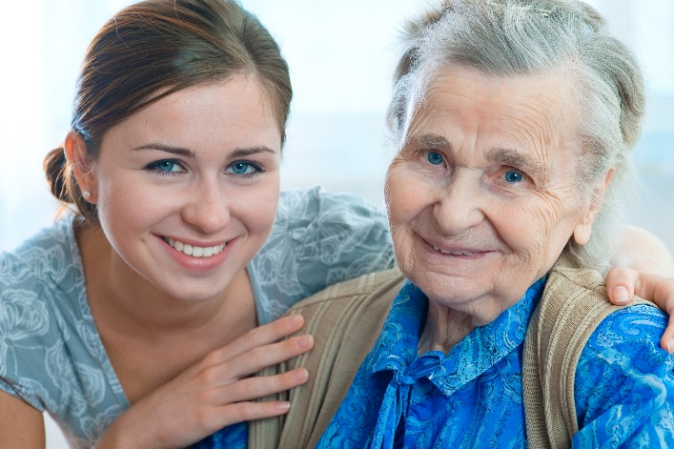
Give Healthy Lifestyle Advice to Elena and Jessica!
If you could give advice to Elena and her granddaughter, Jessica, you would tell them both to stay healthy by:
(circle all healthy behaviors below)
Daily exercise
Avoiding alcohol
Keeping a healthy weight
Talking about
family health history
Regular health screenings and well woman visits
Choosing healthy foods
Not smoking

Slide 10
Cervical Health

Slide 11
What is Cervical Cancer?
Breast cancer starts when cells within the breast grow out of control.
These cells can often be seen on mammography or felt as a lump or nodule.
A tumor is an abnormal growth of cells in the body.
Notes:
Breast Health Glossary
Benign: Not cancer.
Review key terms:
Biopsy: A minor surgical procedure to remove a small piece of tissue that is then examined in a laboratory.
Malignant: Cells or tumors that are able to invade tissue and spread to other parts of the body.
Mammography: A procedure in which X-rays of the breast are used to detect breast cancer.
Screening Test: A test that looks for possible signs of disease.

Slide 12
Signs of Cervical Cancer
Note: Women with early cervical cancers and pre-cancers usually have no symptoms!
That is why regularly scheduled exams are essential, so be sure to get a well woman exam once a year.
Remember...cervical cancer starts when cells within the cervix grow out of control.
Symptoms often do not begin until the cancer grows into nearby tissue.
When this happens, common symptoms are:
Abnormal bleeding
Pelvic pain not related to your menstrual cycle
Heavy or unusual discharge that may be watery, thick, and possibly have a foul odor
Increased urinary frequency
Pain during urination or difficulty urinating
If you ever do have any of these symptoms, please see a health care professional right away.
Pain or difficulty during urination or pain during intercourse.
Abnormal bleeding or unusual discharge from the vagina

Slide 13
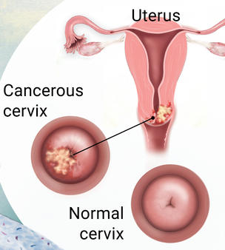
Types of Cervical Cancer
The most common type of cervical cancer is squamous cell carcinoma.
Squamous cells are thin, flat cells that look like fish scales, and are found in the tissue that forms the surface of the skin.
The squamous cells right at the entry of the cervix, at the outermost layer of the skin, are most susceptible to human papilloma virus (HPV).
This is why we do the Pap test and will discuss your test results with you.
Image source: https://www.cancer.gov/types/cervical/understanding-cervical-changes

Slide 14
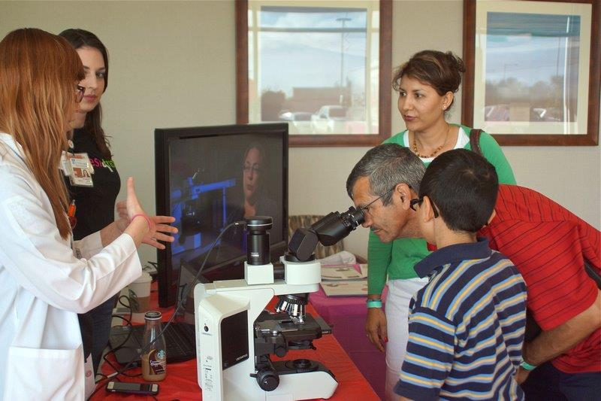
Did You Know?
Embarrassment is one of the major causes of not getting tested for cervical cancer.
Even though women may feel something is wrong, they may not seek help due to fear.
Men have a very important role to play in cervical health. Many women need encouragement to get their routine screenings
Most cases of cervical cancer are caused by infection with HPV, a sexually transmitted virus that enters cervical cells and can cause them to change.
There are over 3,500 preventable deaths from cervical cancer each year.
In most cases, problems can be prevented through early detection and treatment before cancer develops!

Slide 15
What Can Lower the Risk of Cervical Cancer?
If you are over 30, get tested for HPV: The most important risk factor for cervical cancer is infection by HPV. Know your status!
Quit Smoking: Women who smoke are about twice as likely as non-smokers to get cervical cancer.
Keep a Healthy Weight: Overweight women are more likely to develop a form of cancer of the cervix.
Talk About Your Family History: You may be at high risk of cervical cancer if you have a mother or sister who developed cervical or ovarian cancer (especially at an early age) or if you have multiple family members (including males) who developed cervical, ovarian or prostate cancer.
Most importantly, Keep Getting Screened! Regularly scheduled cervical cancer screening remains the single best way to protect yourself from the disease! If you have any questions about the tests, be sure to talk to your Doctor.

Slide 16
Breast Health

Slide 17
What is Breast Cancer?
Breast cancer starts when cells within the breast grow out of control.
These cells can often be seen on mammography or felt as a lump or nodule.
A tumor is an abnormal growth of cells in the body.

Slide 18
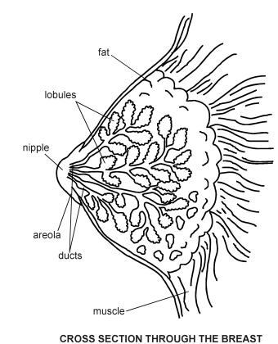
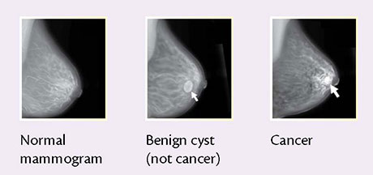
Key Terms and Anatomy of the Breast
If you aren’t sure what a word means, be sure to ask!
Image source: National Cancer Institute
Image source: http://Patient.info/diagram/breast-diagram

Slide 19
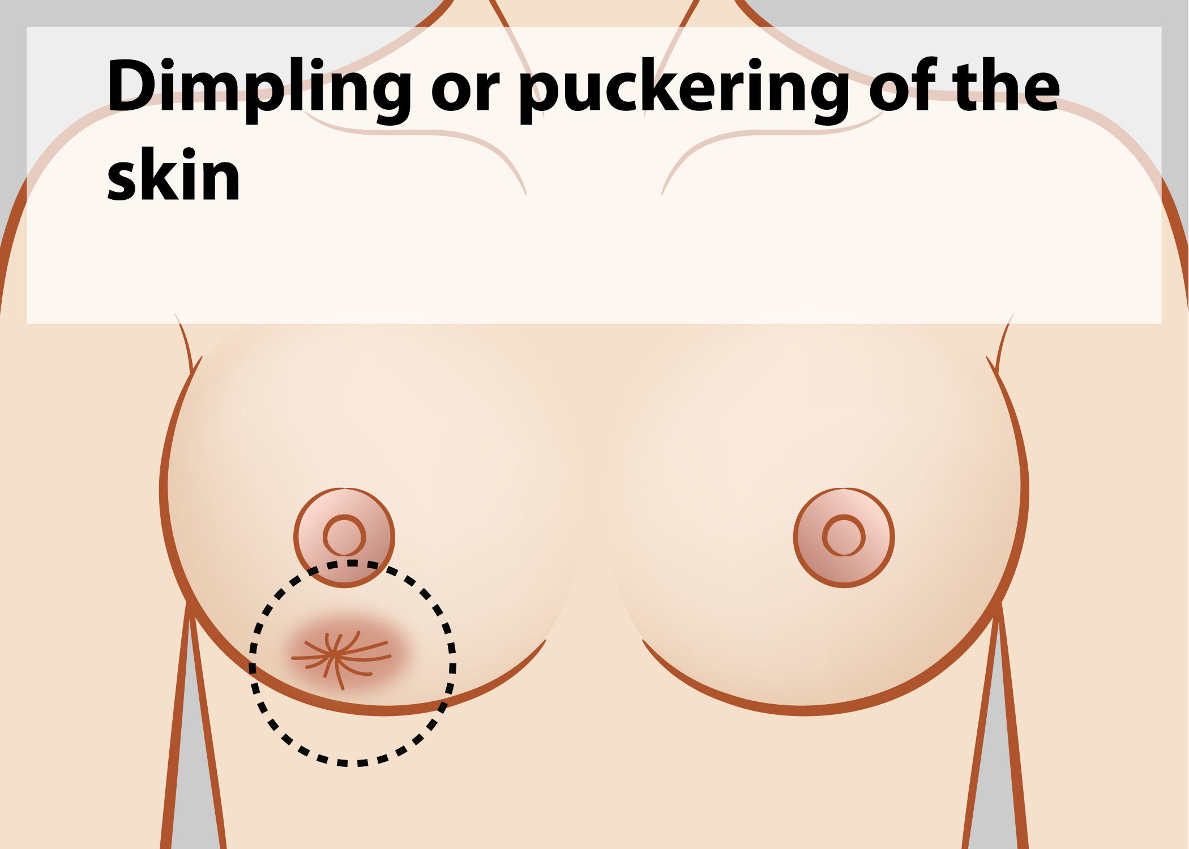
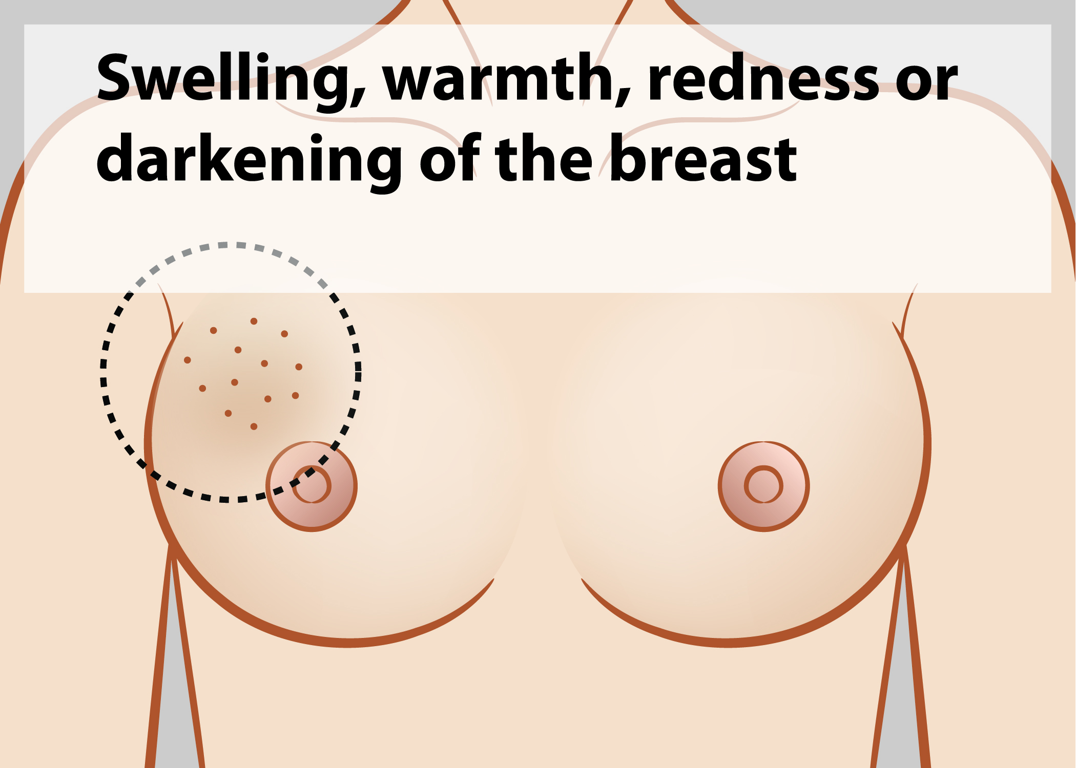
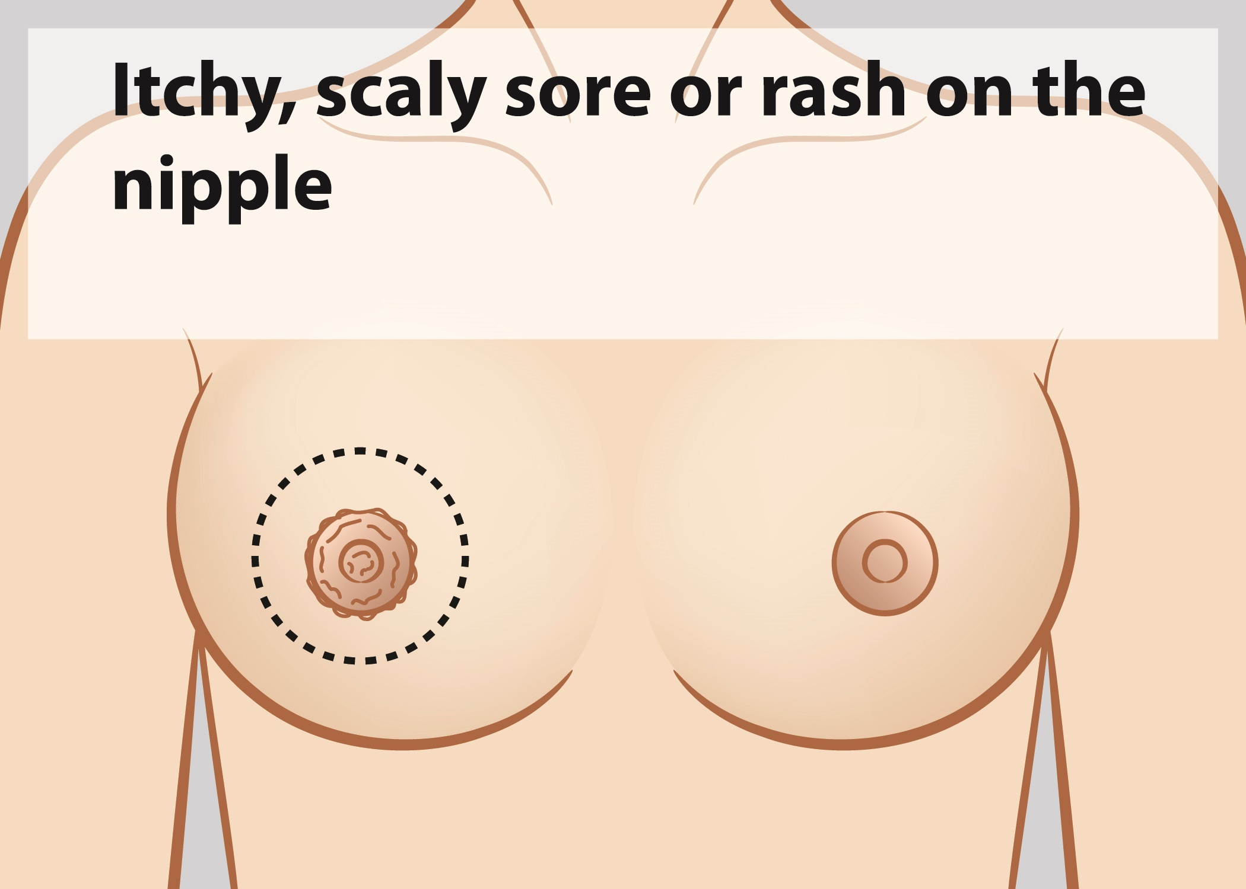
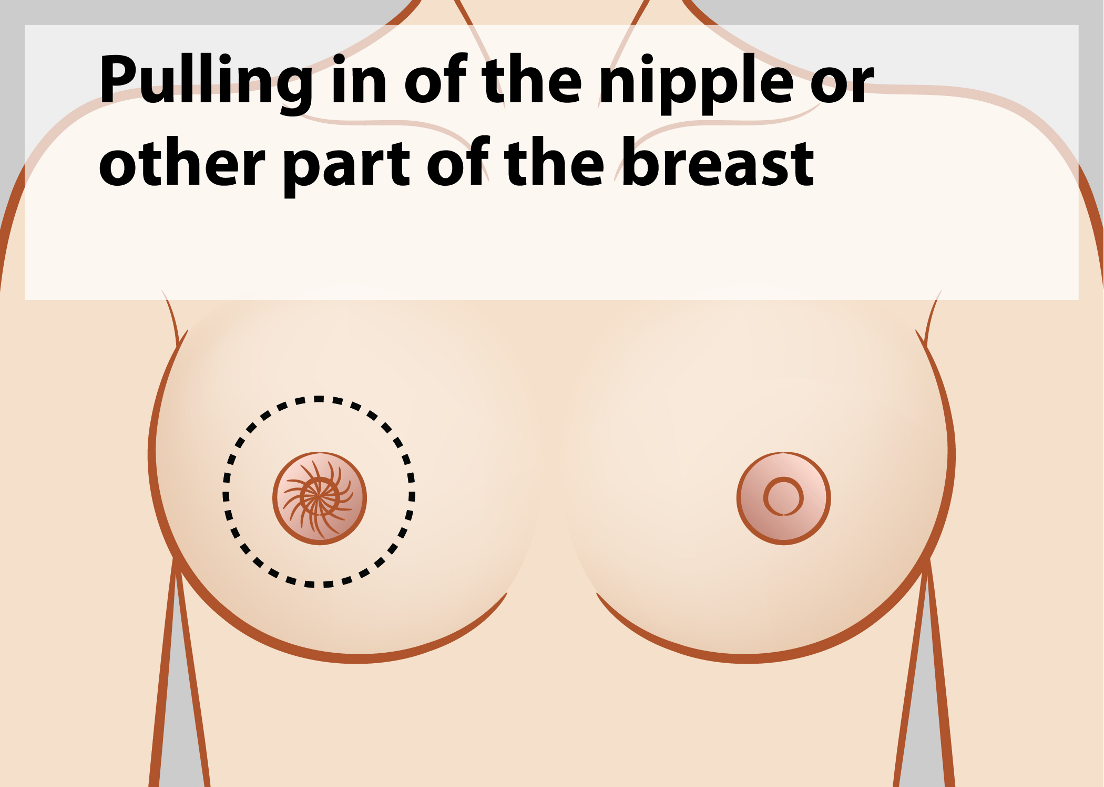
Signs of Breast Cancer
The signs of breast cancer are not the same for all women.
It is very important to know how your breasts normally look and feel.
If you notice any change, see your Doctor!
Skin irritation or dimpling of breast skin
Redness, darkening, or warmth of the breast
Redness, itchiness, soreness or
or thickening of the nipple
Nipple or breast retraction (turning inward)

Slide 20
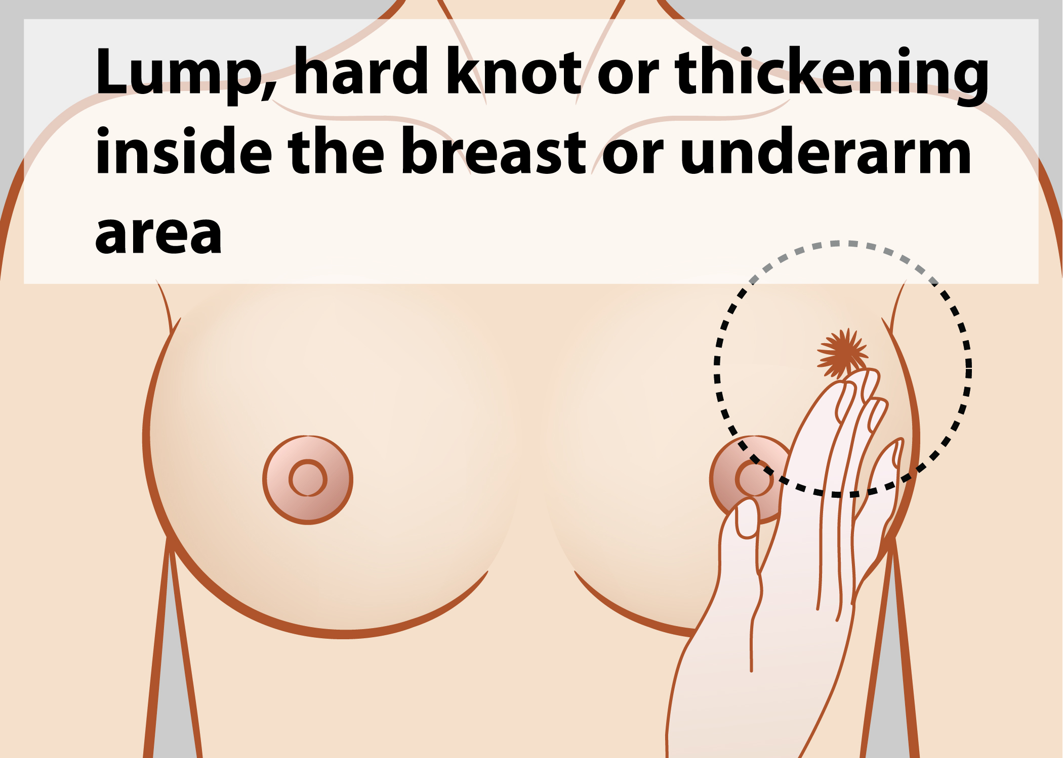
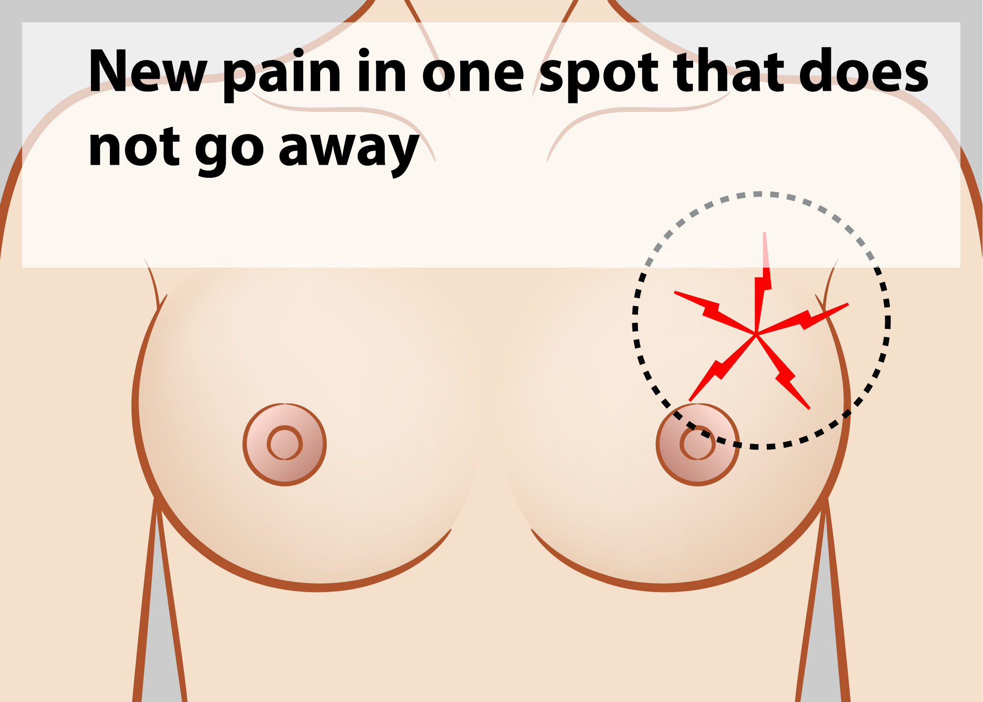
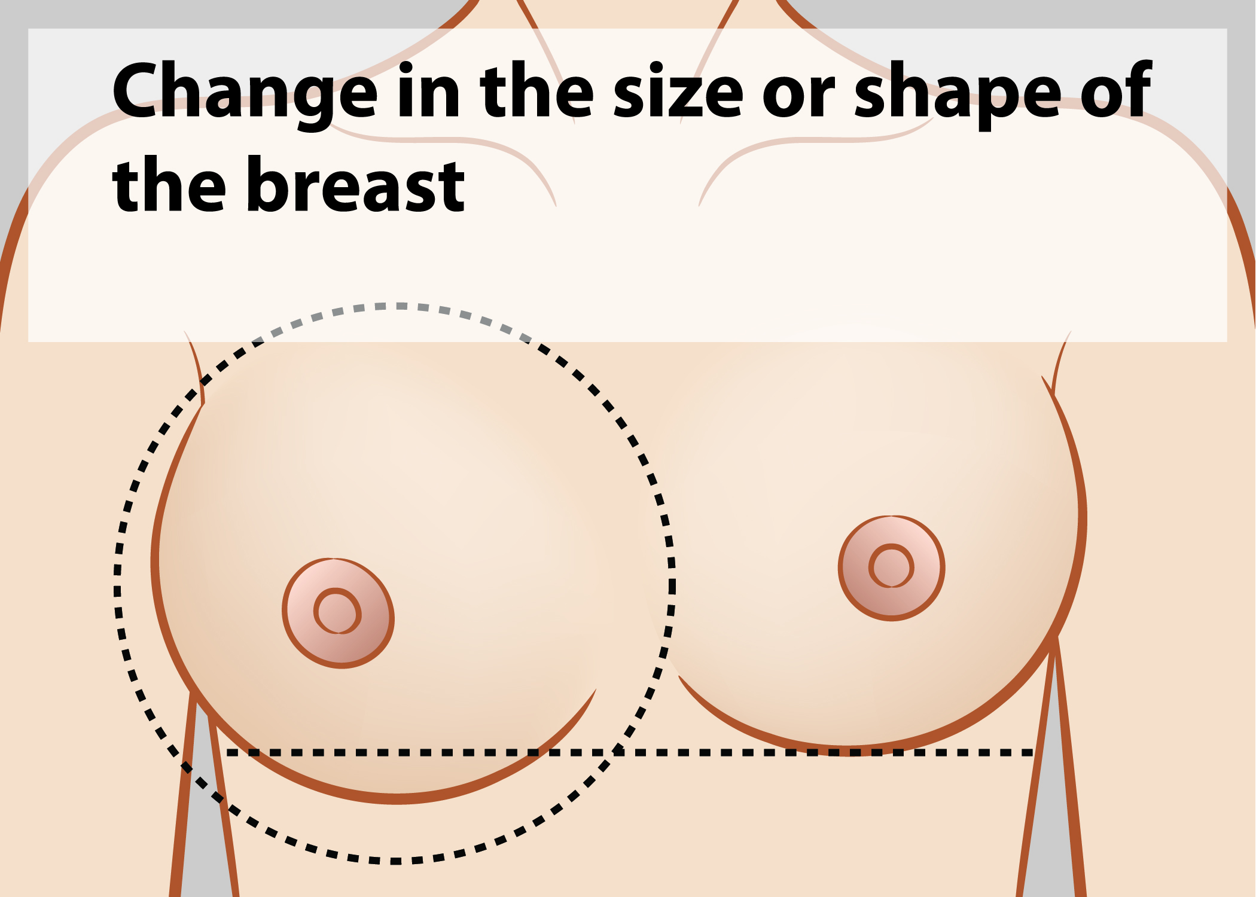
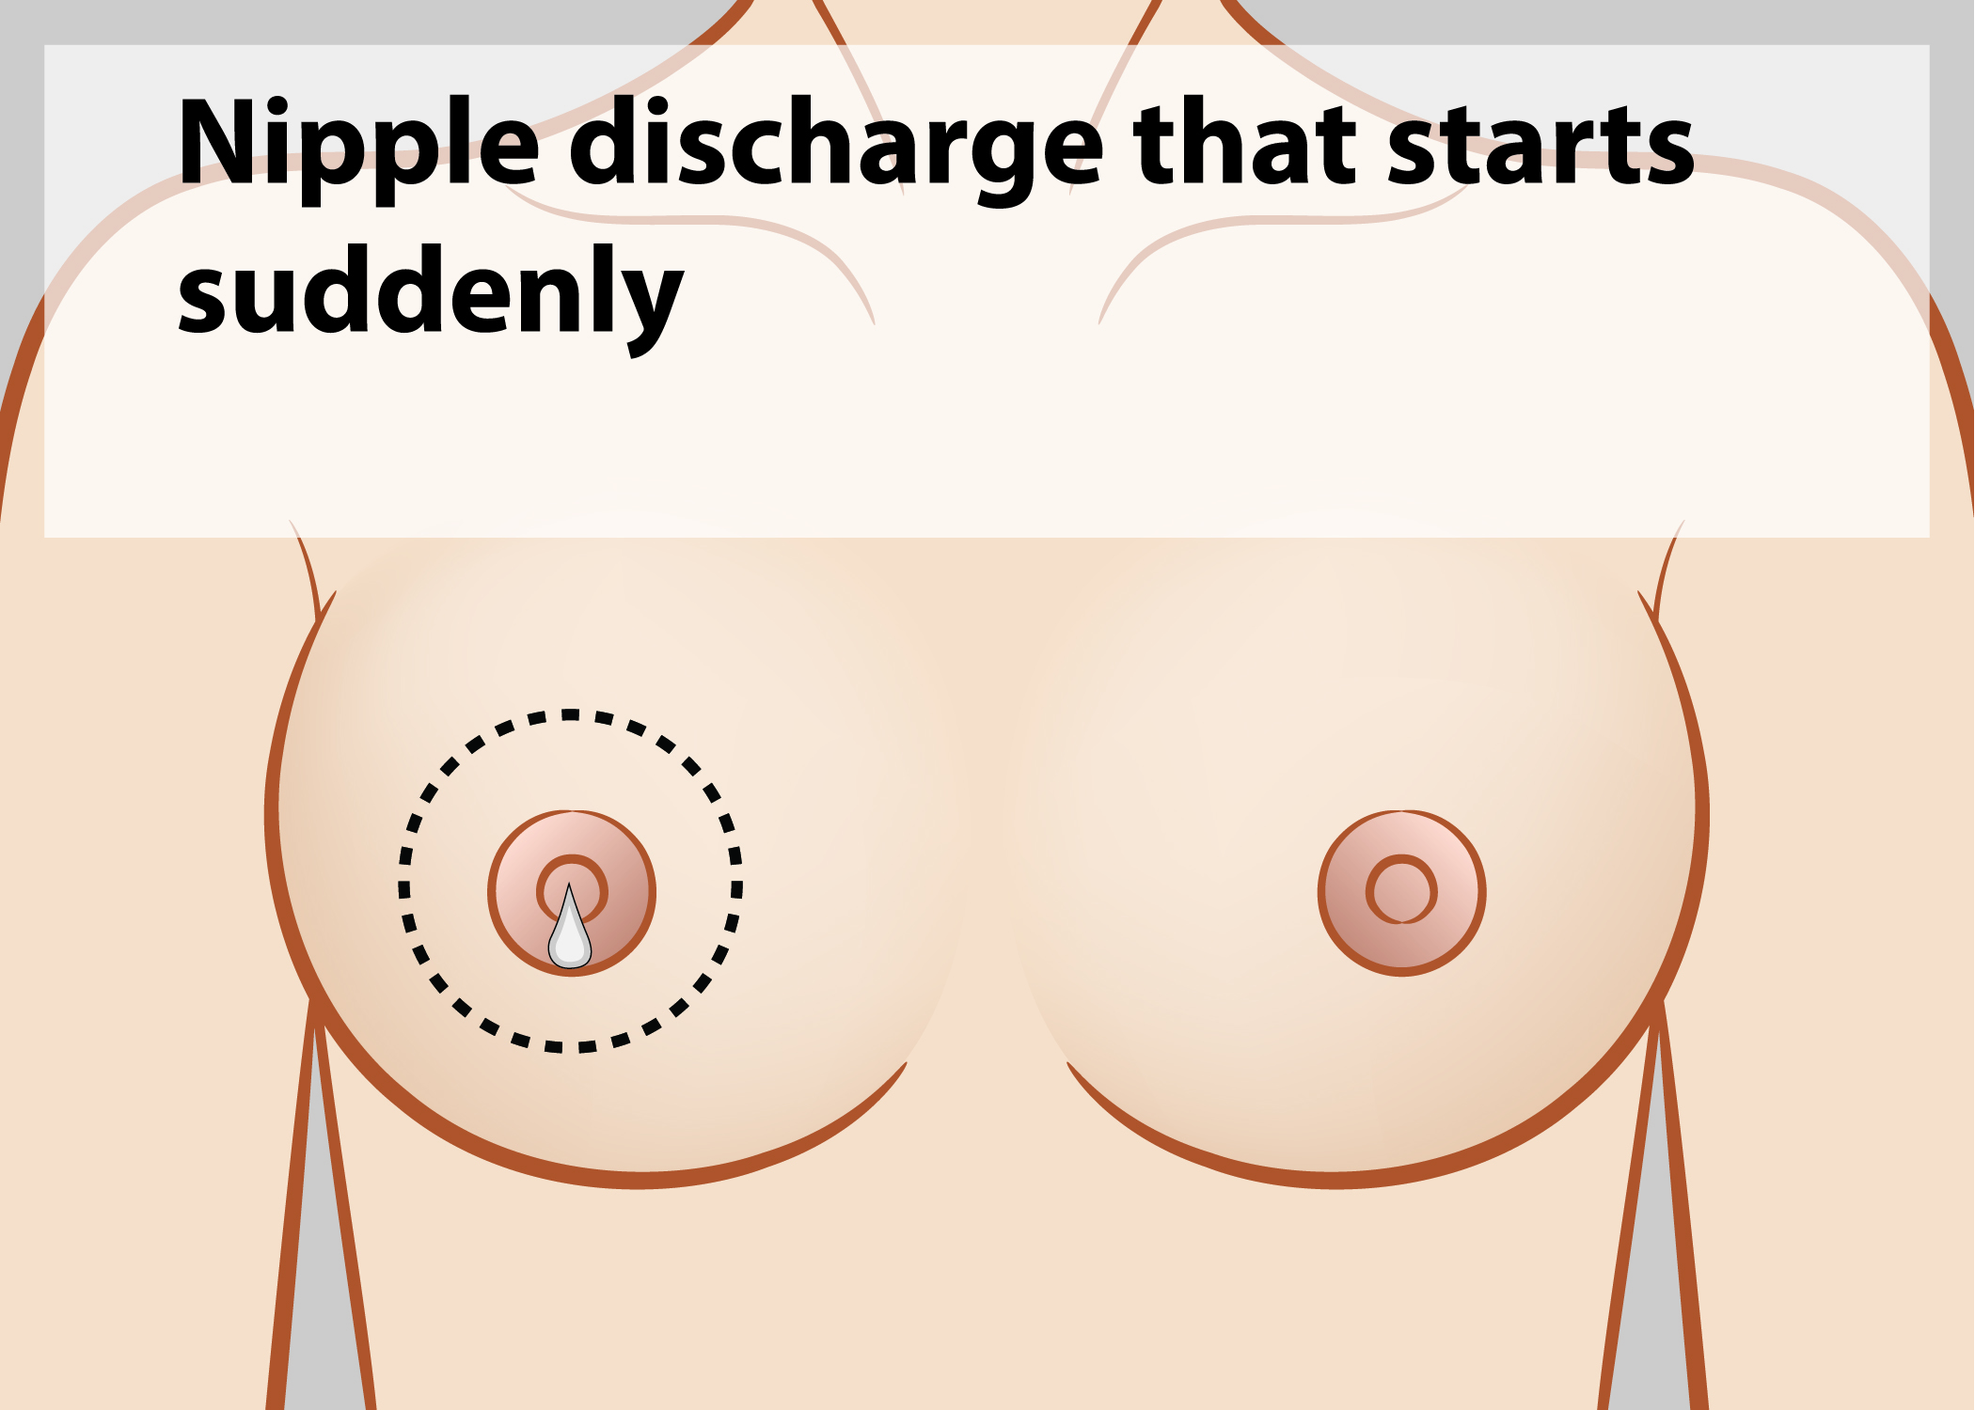
More Signs of Breast Cancer
Chances surviving breast cancer are very good, especially if detected early.
Again, it is very important to know how your breasts normally look and feel and to see your Doctor if you notice any changes.
A lump in the breast or under the armpit
Breast or nipple pain
Swelling of all or part of a breast (even if no lump is felt)
Nipple discharge
(other than breast milk)
20
Notes:
Optional discussion: Ductal carcinoma in situ (DCIS) is the presence of abnormal cells inside a milk duct in the breast. DCIS is considered the earliest form of breast cancer. DCIS is noninvasive , meaning is hasn’t spread outside of the duct into the surrounding breast tissue.

Slide 21
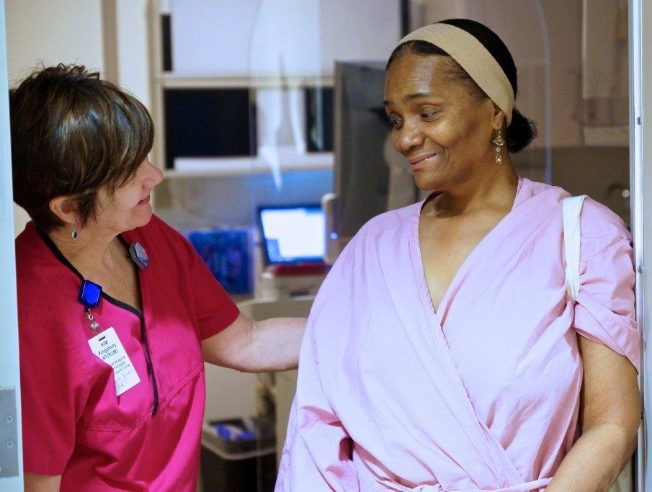
What Can Lower the Risk of Breast Cancer?
Stay Informed:
Get a Mammogram
Keep Getting Screened!
Get Health Insurance
Choose Healthy Foods
Maintain a Healthy Weight
Be Physically Active
Avoid Too Much Alcohol
Breastfeed, If Possible
Avoid Post-Menopausal Hormones
Notes:
Choose Healthy Foods: A diet rich in vegetables and lean proteins, and low in fat and sugar, promotes overall health and energy. There is some evidence that eating fruits and vegetables may slightly lower the risk of some breast cancers.
Maintain a Healthy Weight: Being overweight can increase the risk of many different cancers, including breast cancer.
Be Physically Active: Women who are physically active for at least 30 minutes a day have a lower risk of breast cancer.
Avoid Too Much Alcohol: Only drink alcohol if you drink moderately, which means no more than one drink a day for women.
Breastfeed, If Possible: Breastfeeding lowers the risk of breast cancer. It also has great health benefits for your child!
Avoid Post-Menopausal Hormones: If women do take post-menopausal hormones, it should be for the shortest time possible. Talk about the risks and benefits of post-menopausal hormones with your Doctor.
Stay Informed:
Find Out Your Family History: You may be at high risk of breast cancer if you have a mother or sister who developed breast or ovarian cancer (especially at an early age) or if you have multiple family members (including males) who developed breast, ovarian or prostate cancer.
Keep Getting Screened: Regularly scheduled breast cancer screening remains the single best way to protect yourself from the disease. Screening can help find cancer early, when it’s most treatable!

Slide 22
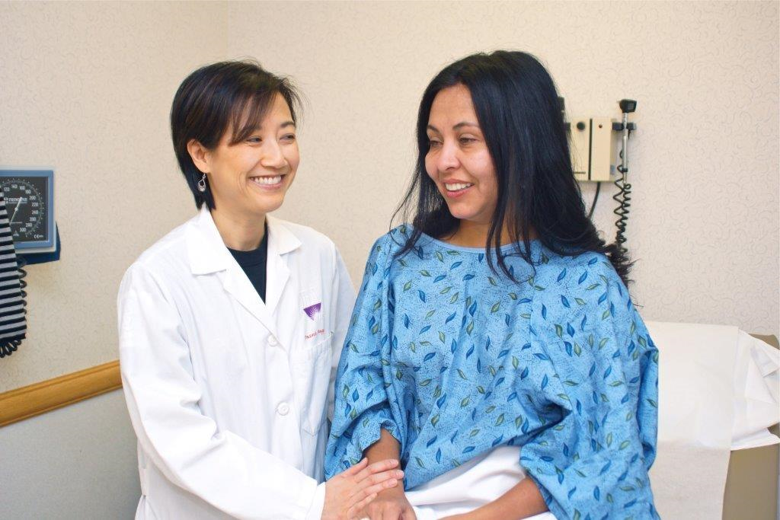
Did You Know?
Cancer can occur at all ages.
Men can get breast cancer.
Chances are 1 in 8 that a woman will get breast cancer.
White women are more likely to get breast cancer.
African American and Hispanic women are more likely to die of breast cancer.
Women aged 29–39 years should have a clinical breast exam every 1–3 years.
Women aged 40 years and older should have a mammogram every year.

Slide 23
Help Lia Talk to Her Friends!
This is Lia and her two friends.
They are all over 40 years old.
Lia wants to give her friends advice to stay healthy!
The best thing she can tell her friends about breast health is:
Get an annual mammogram, do a monthly self-check, and talk to a Doctor if they ever notice changes in their breasts.
Since they’ve never had a problem, tell them don’t worry about it!

Slide 24
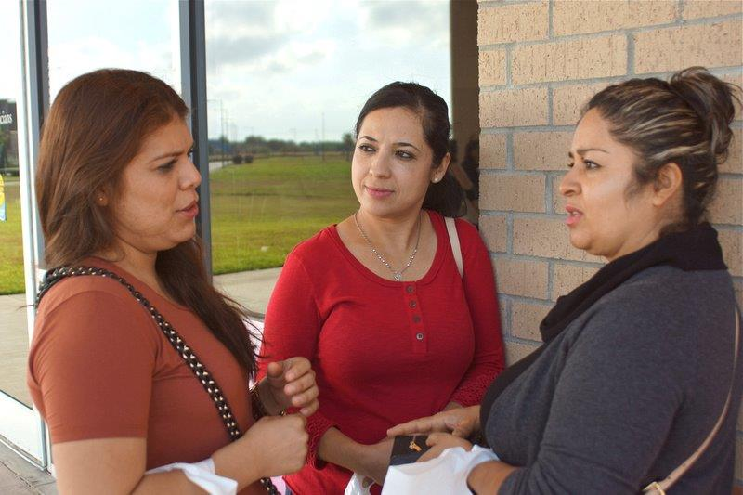
Help These Friends Talk About HPV!
This is Valeria and her closest friends. Valeria is feeling embarrassed about getting a diagnosis of HPV.
Valeria’s friends want her to stay healthy and feel supported!
Her friends should tell her…
(circle everything that is true below)
Many women get HPV and it will probably just go away, but she has to get regularly screened to make sure!
Keep getting pelvic and Pap exams and talk to a Doctor immediately if she ever has discharge, bleeding, or feels pain.

Slide 25
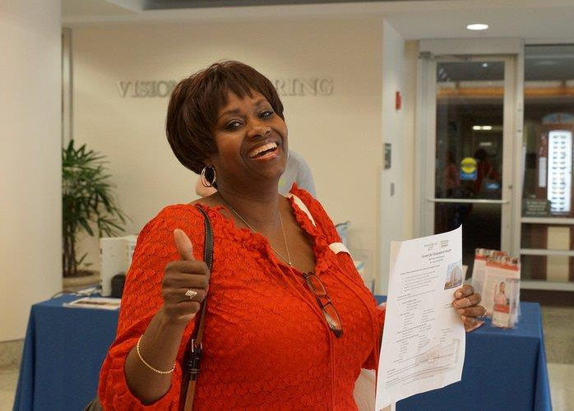
Do you have any questions about:
What cancer is?
The roles of your Doctors and nurses in helping you stay healthy?
The warning signs of cervical and breast cancer?
The behaviors that promote health, including screening and early detection through Pap tests, mammograms and well woman visits?

Slide 26
Optional Presentation Materials
The Health Literacy Special Collection from the National Institute for Literacy: What A Friend Can Do For You ”Photonovel” about breast exams and mammograms. http://healthliteracy.worlded.org/heal/friends/index.html My Life Story with Cancer ”Photonovel” http://healthliteracy.worlded.org/docs/Mary/introduction.html Breast Cancer As I Lived It http://healthliteracy.worlded.org/docs/MScanlon2/index.htm The National Cancer Institute (NCI) Cervical Cancer: Did You Know? https://www.youtube.com/watch?v=Cts3nGux91k&feature=youtu.be https://www.youtube.com/watch?v=UlmDRCUPPu4&feature=youtu.be https://www.youtube.com/watch?v=Du1dnKppn-s&list=UUiMg06DjcUk5FRiM3g5sqoQ The Foundation for Women’s Cancer What Every Woman Should Know: Cervical Cancer (English) What Every Woman Should Know: Cervical Cancer (Spanish) You Can Prevent Cervical Cancer What is the HPV Vaccine and Who Should Receive It? Cervical Cancer and Smoking HPV and Men The American Cancer Society’s library: http://www.cancer.org/healthy/toolsandcalculators/videos/index

Slide 27
Reusable Graphics
Please be sure to give credit to The Noun Project for any re-use of of the black and white icon images found within this presentation. Additional images include:
This educational module is the property of the CAP Foundation. The material within is presented for entirely non-profit, educational purposes. Permission to reproduce this work, in part or in entirety, for any purpose other than use in the See, Test & Treat program must be granted in writing by the CAP Foundation.

Slide 28
You May Use This Template to Add Your Own Slides

